Slide 1
Quantum Computation and Simulation
Christopher Monroe
Joint Quantum Institute and Department of Physics
NIST and University of Maryland

Slide 2
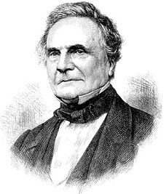
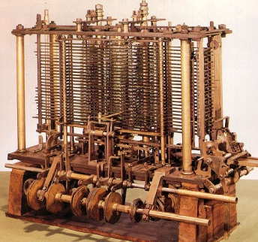
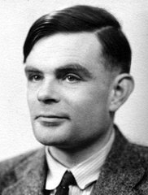
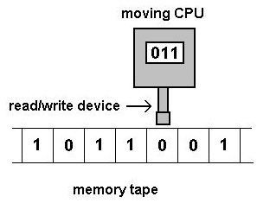
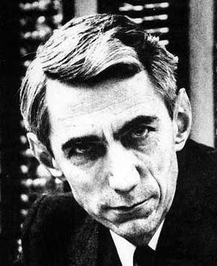
Computer Science and Information Theory
Charles Babbage (1791-1871)
mechanical difference engine
Alan Turing (1912-1954)
universal computing machines
Claude Shannon (1916-2001)
quantify information: the bit

Slide 3
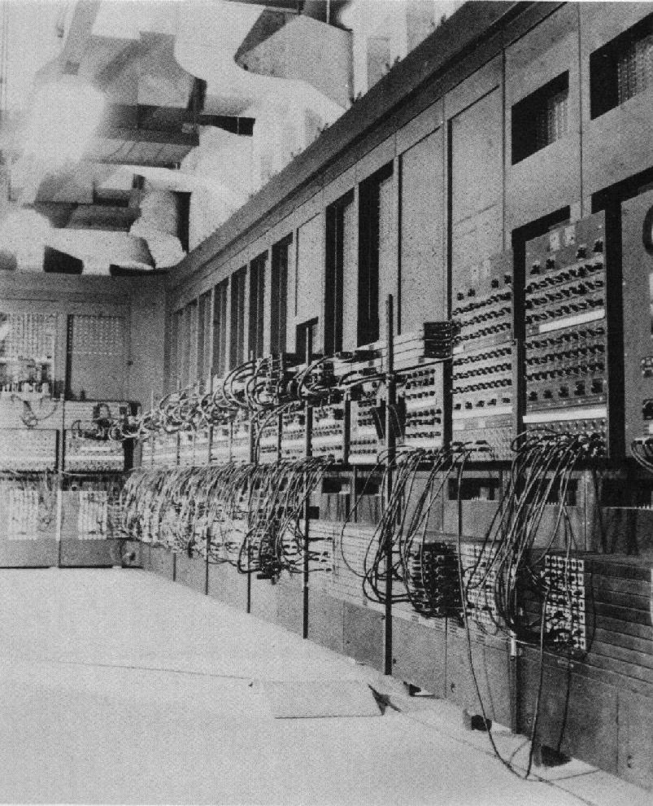
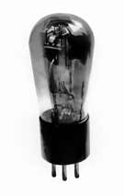
ENIAC
(1946)

Slide 4
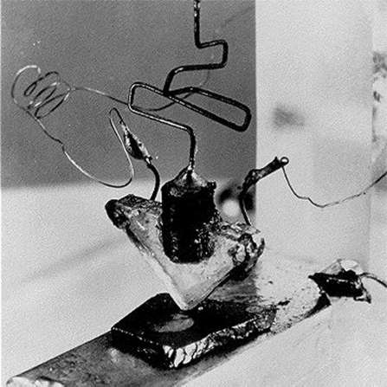
The first solid-state transistor
(Bardeen, Brattain & Shockley, 1947)

Slide 5
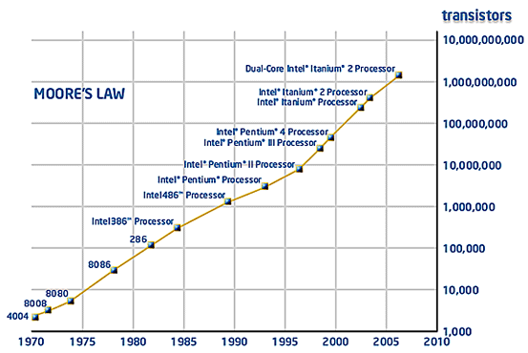
Quantum Mechanics and Computing
atom-sized
transistors
molecular-sized
transistors
2025
2040
“There's Plenty of Room at the Bottom” (1959)
“When we get to the very, very small world – say circuits of seven atoms – we have a lot of new things that would happen that represent completely new opportunities for design.
Atoms on a small scale behave like nothing on a large scale,
for they satisfy the laws of quantum mechanics…”
Richard Feynman

Slide 6
Application 1. Quantum Factoring
P. Shor (1994)
A quantum computer can factor numbers
exponentially faster than classical computers
15 = 3 × 5 (…easy)
38647884621009387621432325631 = ? × ?
Importance: cryptanalysis
public key cryptography relies on inability to factor large numbers
Application 2: Quantum Search
L. Grover (1997)
A quantum computer can finding a marked entry in an unsorted database quadratically faster than classical computers
(e.g., given a phone number, finding the owner’s name in a phonebook)
Importance: “satisfiability” problems
fast searching of big data
inverting complex functions
determining the median or other global properties of data
pattern recognition; machine vision
Notes:
This is Shor’s algorithm, the “killer app” of quantum computing

Slide 7
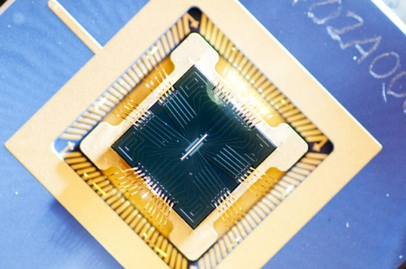
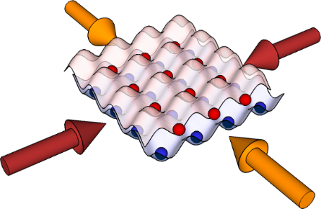
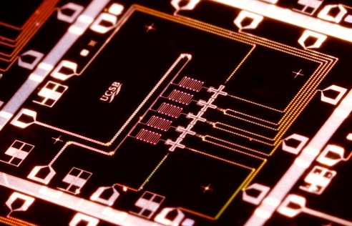
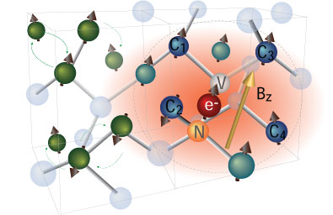
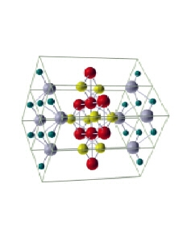
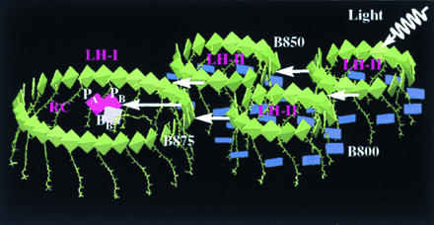
Application 3: Quantum Simulation
$$iℏ\frac{∂Ψ}{∂t}=HΨ$$
Quantum modelling is hard: N quantum systems require
solution to 2^{N} coupled eqns
Alternative approach: Implement model of interacting system on a quantum simulator, or “standard” set of qubits with programmable interactions
Atomic ions Trapped atoms Superconductors NV-diamond
Quantum Material Design Understand exotic material properties
or design new quantum materials from the bottom up
Energy and Light Harvesting Use quantum simulator to program QCD lattice gauge theories, test ideas connecting cosmology to information theory (AdS-CFT etc..)
Quantum Field Theories Program QCD lattice gauge theories, test ideas connecting cosmology to information theory (AdS-CFT etc..)
high-T_{C}
super-
conductor
Notes:
This is Shor’s algorithm, the “killer app” of quantum computing

Slide 8
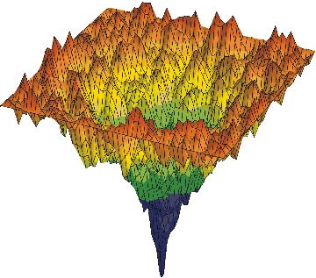
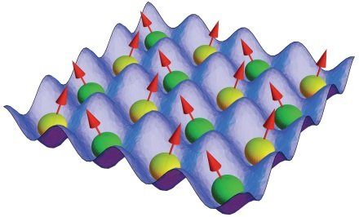
Application 4: Quantum Optimization
x₂
Minimizing complex (nonlinear) functions by
“simultaneously sampling” entire space
through quantum superposition
Example: quadratic optimization
Minimize
this function maps to energy of
quantum magnetic network
Relevant to
Logistics
Operations Research
VLSI design
Finance
x₁
global minimum
of f (x₁,x₂ )
$$f(x1, x2,…)=\sum_{i<j}{q_{ij}x_{i}x_{j}+\sum_{i}{c_{i}x_{i}}}$$
Killer Application?
could crack a large class of intractable problems: factoring, “traveling salesman” problem, etc..
BUT not known if there is always a quantum speedup

Slide 9
Application 5: Quantum Networks
Location A
Distance L
(0.1m – 10,000km)
Location B
Quantum
Network
Location C
Location D
Uses of a quantum network
Secret key generation: cryptography
Certifiable random number generation
Quantum repeaters (“amplifiers”)
Distributed quantum entanglement for optimal decision making
Large-scale quantum computing
Notes:
Exclamation mark from the first example in “Types of Applications” removed.

Slide 10
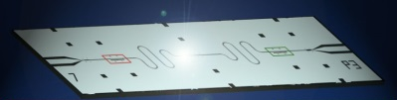
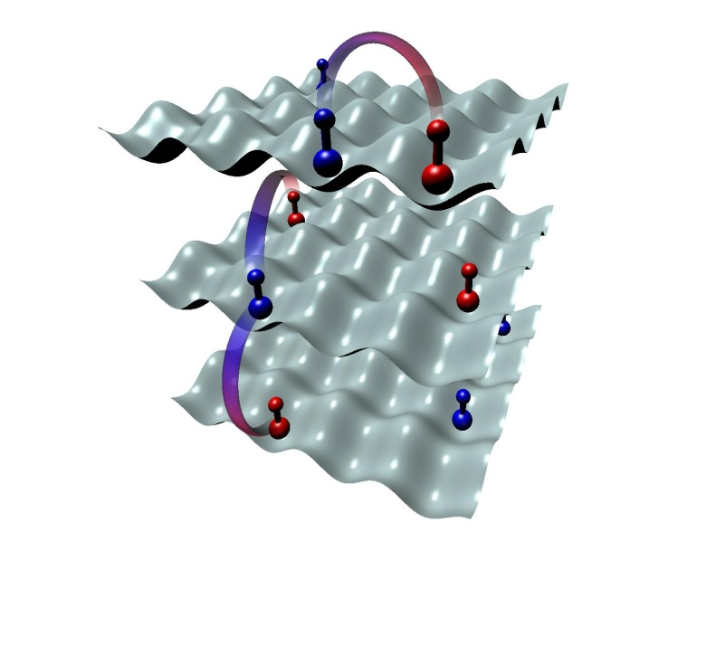
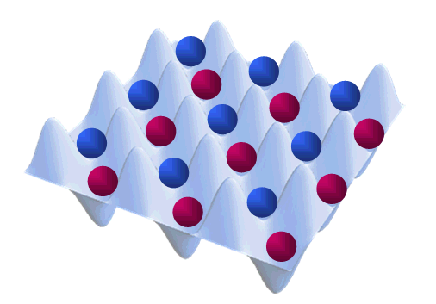
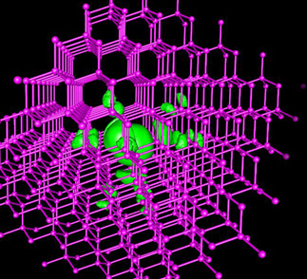
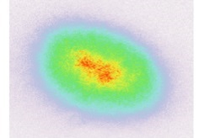
Implementation of Quantum Hardware
quantum materials by design
complex optimization
“big quantum data”
quantum computing
control &
configurability
trapped
ions
Verification?
Cannot model
superconductors
molecules
NV
Q-dots
neutral
atoms
# particles

Slide 11
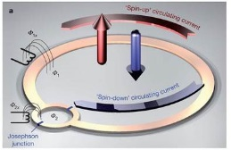
Leading Quantum Computer Hardware Candidates
Trapped Atomic Ions
FEATURES & STATE-OF-ART
very long (>>1 sec) memory
5-20 qubits demonstrated
atomic qubits all identical
connections reconfigurable
CHALLENGES
lasers & optics
high vacuum
4K cryogenics
engineering needed
lasers
individual
atoms
photon
IARPA Lockheed
DoD Honeywell
Sandia UK Gov’t
Atomic qubits connected through
laser forces on motion or photons
Investments:
Superconducting Circuits
FEATURES & STATE-OF-ART
connected with wires
fast gates
5-10 qubits demonstrated
printable circuits and VLSI
CHALLENGES
short (10⁻⁶ sec) memory
0.05K cryogenics
all qubits different
not reconfigurable
LARGE
Investments:
IARPA Lincoln Labs
DoD Intel/Delft
Google/UCSB IBM
Superconducting qubit:
right or left current
NV-Diamond and other solid state “atoms”
Atoms in optical lattices
Semiconductor gated quantum dots
Others: still exploratory

Slide 12
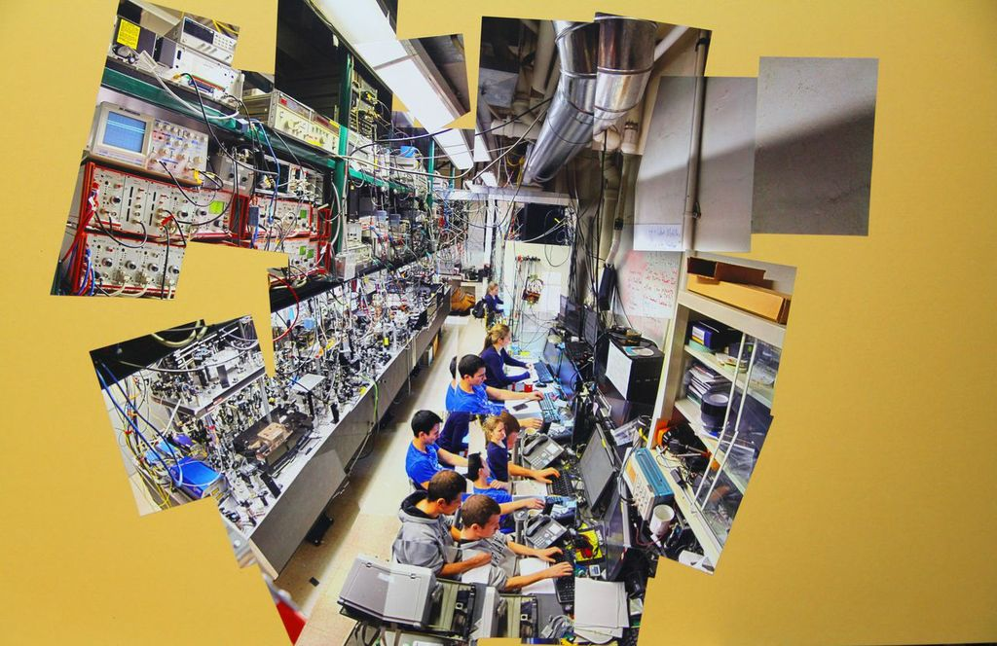

Slide 13
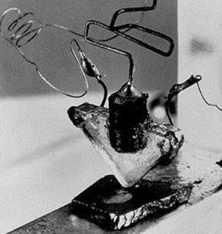
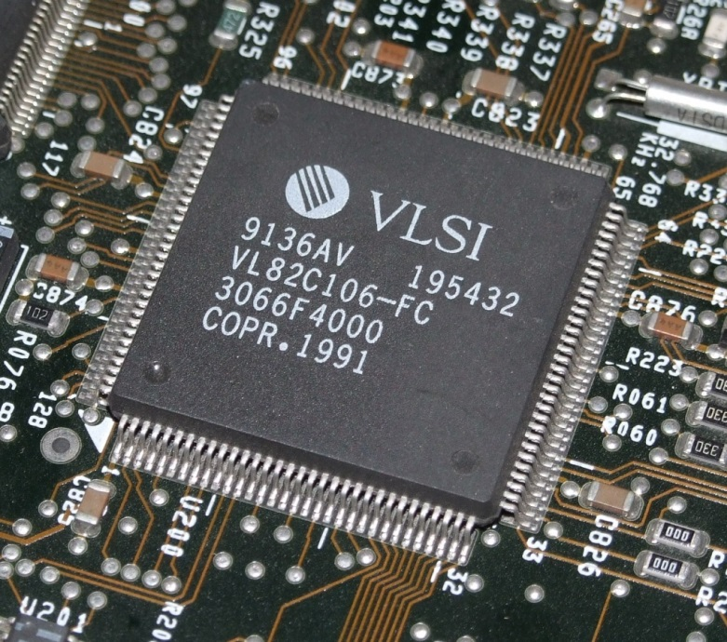
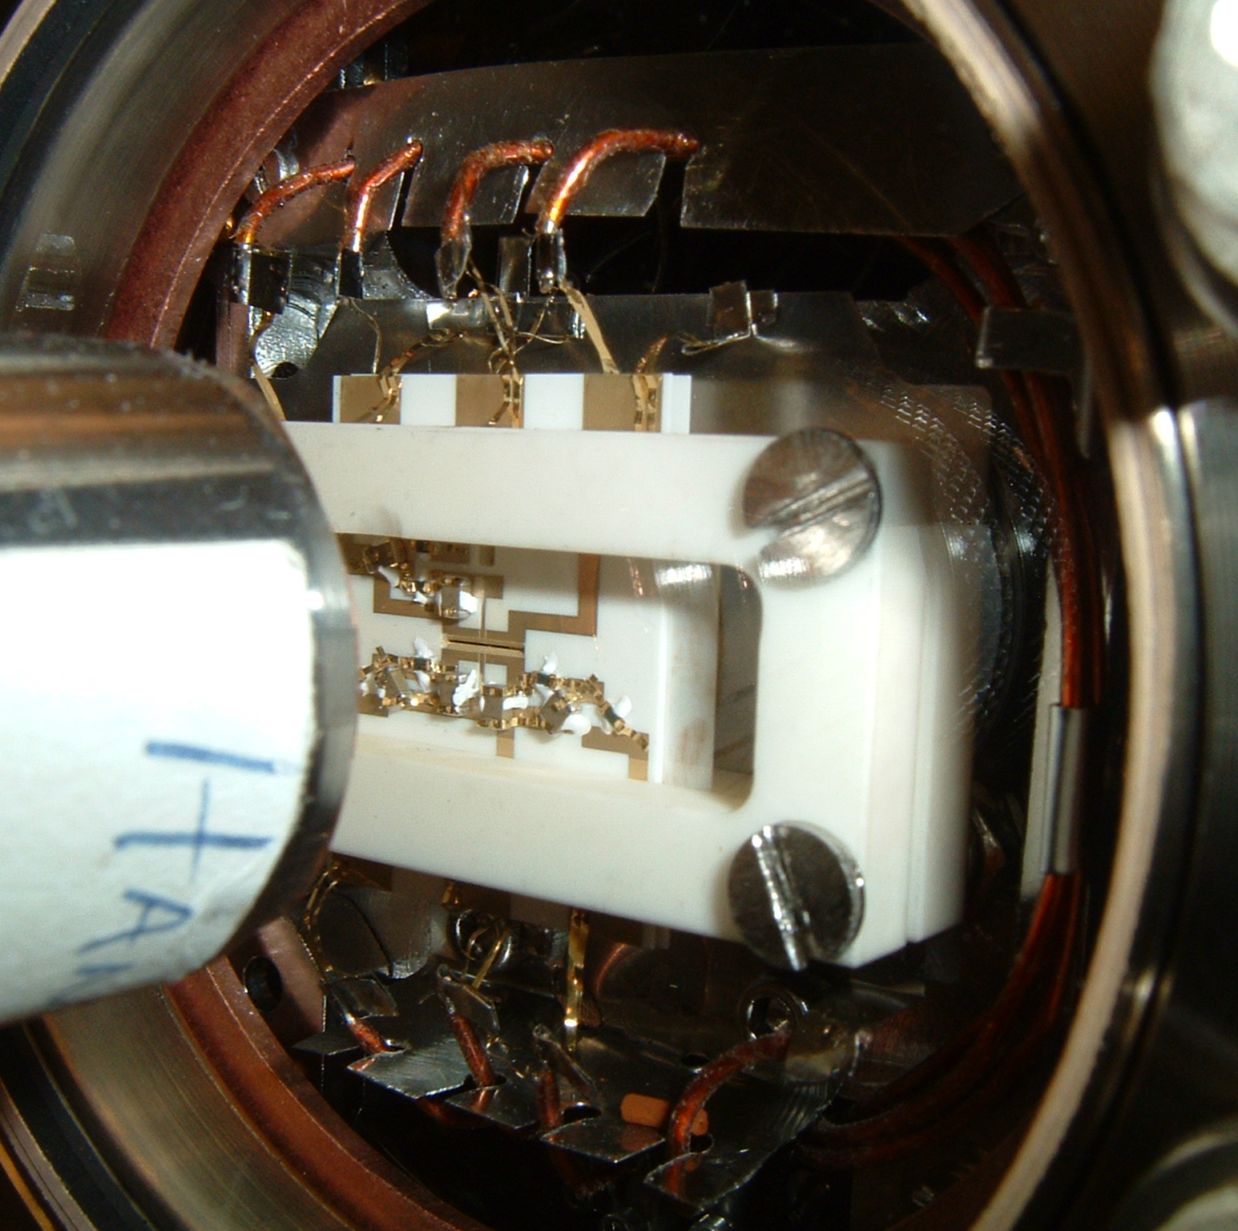
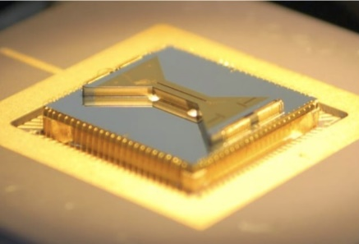
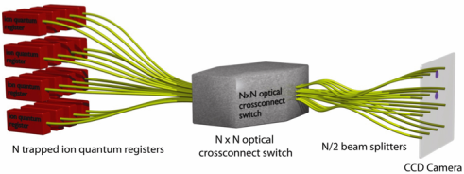
1947: first transistor
2000: integrated circuit
single module
Quantum Engineering
Needed!
N ion trap modules
2015: qubit collection
Large scale quantum network?

