Slide 1
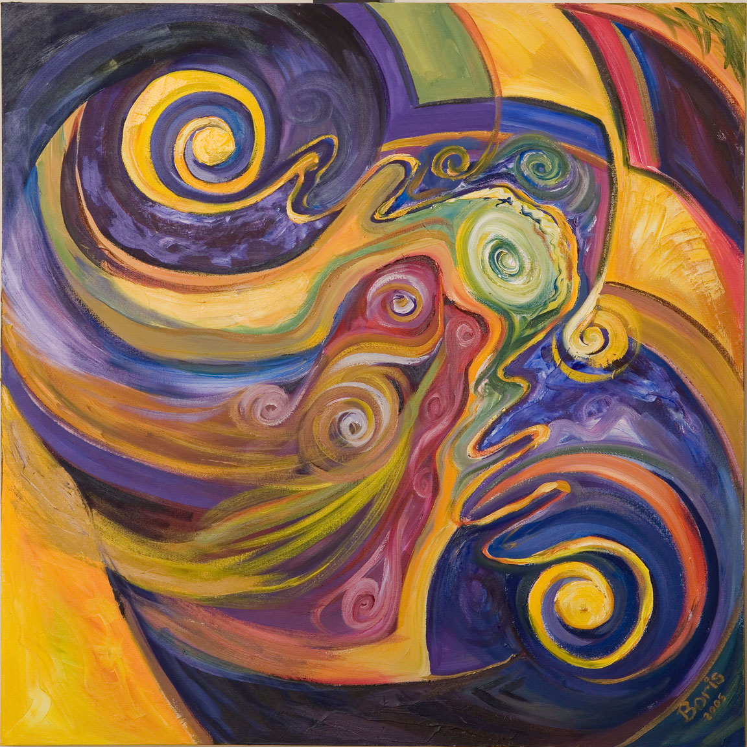
Scaling the Ion Trap:
Breaking Quantum Badness
Chris
Monroe
University of Maryland
Department of Physics
JOINT
QUANTUM
INSTITUTE
National Institute of
Standards and Technology

Slide 2
“There's Plenty of Room
at the Bottom” (1959)
Richard Feynman
“When we get to the very, very small world – say circuits of seven atoms - we have a lot of new things that would happen that represent completely new opportunities for design. Atoms on a small scale behave like nothing on a large scale, for they satisfy the laws of quantum mechanics…”

Slide 3
GOOD NEWS…
quantum parallel processing on 2^{N} inputs
Example: N=3 qubits
Ψ = a₀ |000⟩ + a₁|001⟩ + a₂ |010⟩ + a₃ |011⟩
a₄ |100⟩ + a₅|101⟩ + a₆ |110⟩ + a₇ |111⟩
f(x)
N=300 qubits: more information
than particles in the universe!
…BAD NEWS…
Measurement gives random result
f(x)
e.g., Ψ ⇒ |101⟩
Notes:
Good-bad-good. Exponential storage. X2 example of parallelism.

Slide 4
…GOOD NEWS!
quantum interference
depends on all inputs
Deutsch (1985)
Shor (1994)
Grover (1996)
toy quantum algorithms
fast number factoring N = p×q
fast database search
Notes:
Shor started it all

Slide 5
…GOOD NEWS!
quantum interference
quantum
logic gates
depends on all inputs
quantum
√NOT gate:
|0⟩ → |0⟩ + |1⟩
|1⟩ → |1⟩ − |0⟩
quantum
XOR gate:
|0⟩ |0⟩ → |0⟩ |0⟩
|0⟩ |1⟩ → |0⟩ |1⟩
|1⟩ |0⟩ → |1⟩ |1⟩
|1⟩ |1⟩ → |1⟩ |0⟩
( )
e.g., |0⟩ + |1⟩ |0⟩ → |0⟩|0⟩ + |1⟩|1⟩
superposition → entanglement
Notes:
Shor started it all

Slide 6
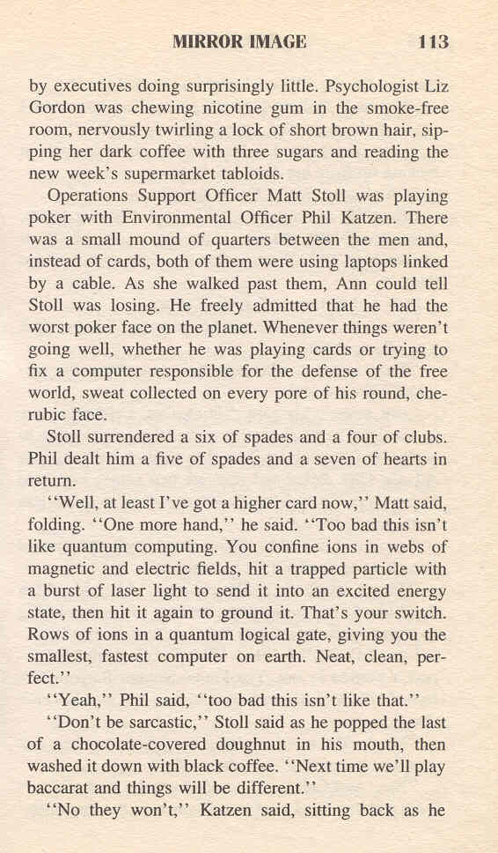

Slide 7
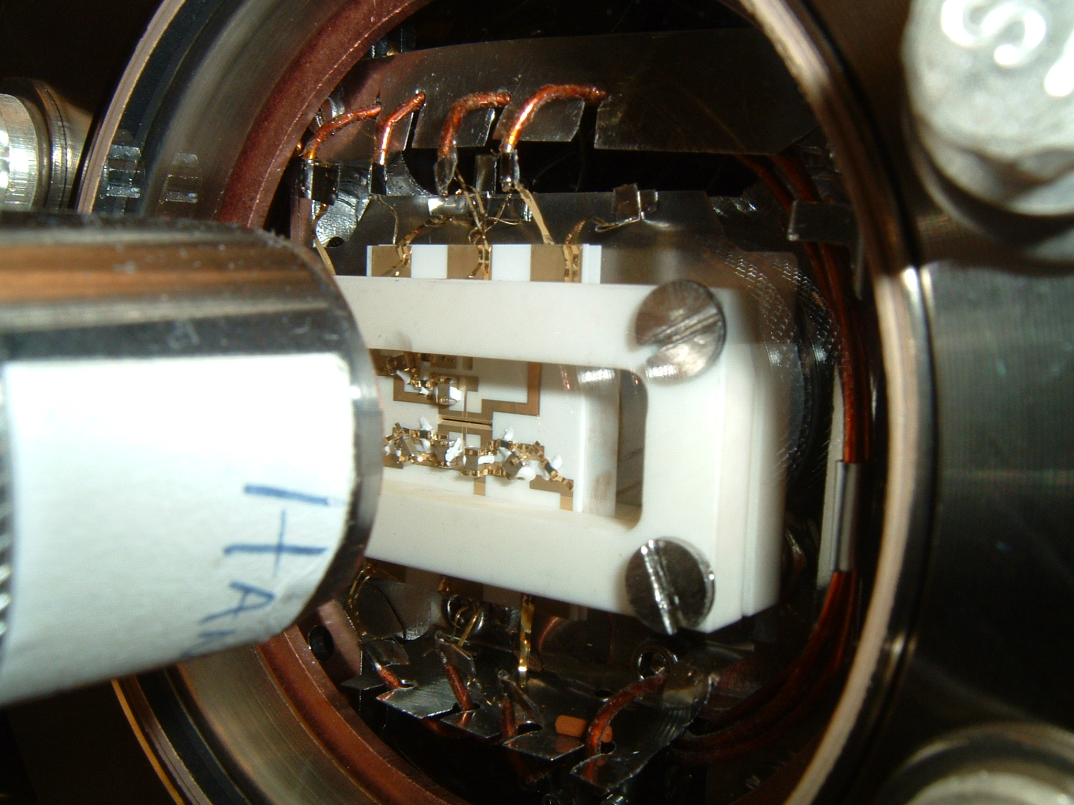
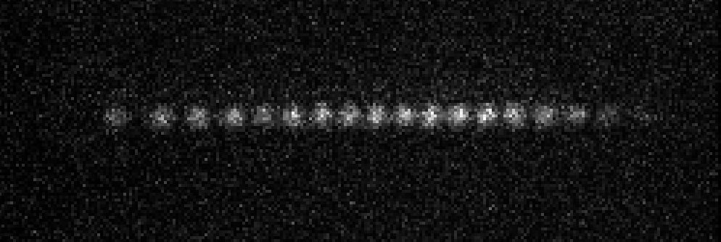
Trapped Atomic Ions
Yb⁺ crystal
Aarhus
Beijing (Tsinghua)
Berkeley
Boulder (NIST)
Denison
Duke
Freiburg
Georgia Tech
Griffith (Australia)
Innsbruck
Lincoln Labs
Maryland/JQI
Mainz
MIT
Munich
Northwestern
Oxford
Paris
Saarbrucken
Sandia
Siegen
Seattle (UW)
Simon Fraser
Singapore
Sussex
Sydney
Tokyo
UCLA
Weizmann Inst.
Zurich (ETH)
~5 mm

Slide 8
¹⁷¹Yb⁺ hyperfine qubit
²S_{1/2}
|↑⟩ = |1,0⟩
ω_{HF}/2π = 12 642 812 118 + 311B² Hz
(600 Hz/G @ 1 G)
|↓⟩ = |0,0⟩

Slide 9
¹⁷¹Yb⁺ qubit detection
1
γ/2π = 20 MHz
²P_{1/2}
2.1 GHz
Probability
|↑_{z}⟩
369 nm
0
0
5
10
15
20
25
# photons collected in 800 ms
²S_{1/2}
|↑⟩ = |1,0⟩
ω_{HF}/2π = 12 642 812 118 + 311B² Hz
(600 Hz/G @ 1 G)
|↓⟩ = |0,0⟩

Slide 10
¹⁷¹Yb⁺ qubit detection
1
>99.9%
detection
efficiency
γ/2π = 20 MHz
²P_{1/2}
2.1 GHz
Probability
|↓_{z}⟩
|↑_{z}⟩
369 nm
0
0
5
10
15
20
25
# photons collected in 500 ms
²S_{1/2}
|↑⟩ = |1,0⟩
ω_{HF}/2π = 12 642 812 118 + 311B² Hz
(600 Hz/G @ 1 G)
|↓⟩ = |0,0⟩

Slide 11
¹⁷¹Yb⁺ qubit manipulation
²P_{3/2}
Δ/2π = 33 THz
²P_{1/2}
γ/2π = 20 MHz
355 nm
²S_{1/2}
|↑⟩
ω_{HF}/2π = 12 642 812 118 + 311B² Hz
(600 Hz/G @ 1 G)
|↓⟩

Slide 12
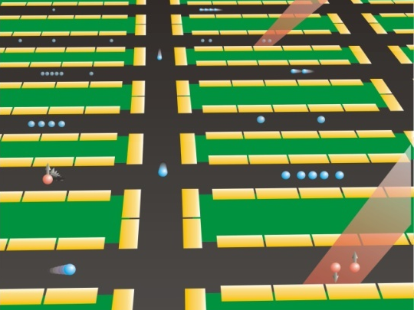
Ion Trap Quantum Networks
Local connections through the
Coulomb interaction
Shuttling atoms through space
Nonlocal connections
with photons

Slide 13
Qubit state-dependent force
~5 μm
↑
↑
↓
↓
δ
d
dipole-dipole coupling
δ ~ 20 nm
eδ ~ 1000 Debye
Cirac and Zoller (1995)
Mølmer & Sørensen (1999)
C.M. & D. J. Wineland (1995, 2000)

Slide 14
Spinoff: Quantum-Gate Clockwork
Till Rosenband, Dave Wineland (NIST-Boulder)
Coulomb
interaction
¹P₁
²P_{3/2}
³P₀
|↑⟩_{Al}
λ = 280 nm
Al⁺
λ = 167 nm
λ = 267 nm
|↑⟩_{Mg}
(F=2, m_{F} = -2)
²⁵Mg⁺
²S_{1/2}
¹S₀
|↓⟩_{Al}
|↓⟩_{Mg}
(F=3, m_{F} = -3)
superposition of
collective motion
α|↓⟩_{Al} + β|↑⟩_{Al} → → α|↓⟩_{Mg} + β|↑⟩_{Mg}
P. O. Schmidt et al., Science 309, 749 (2005)

Slide 15
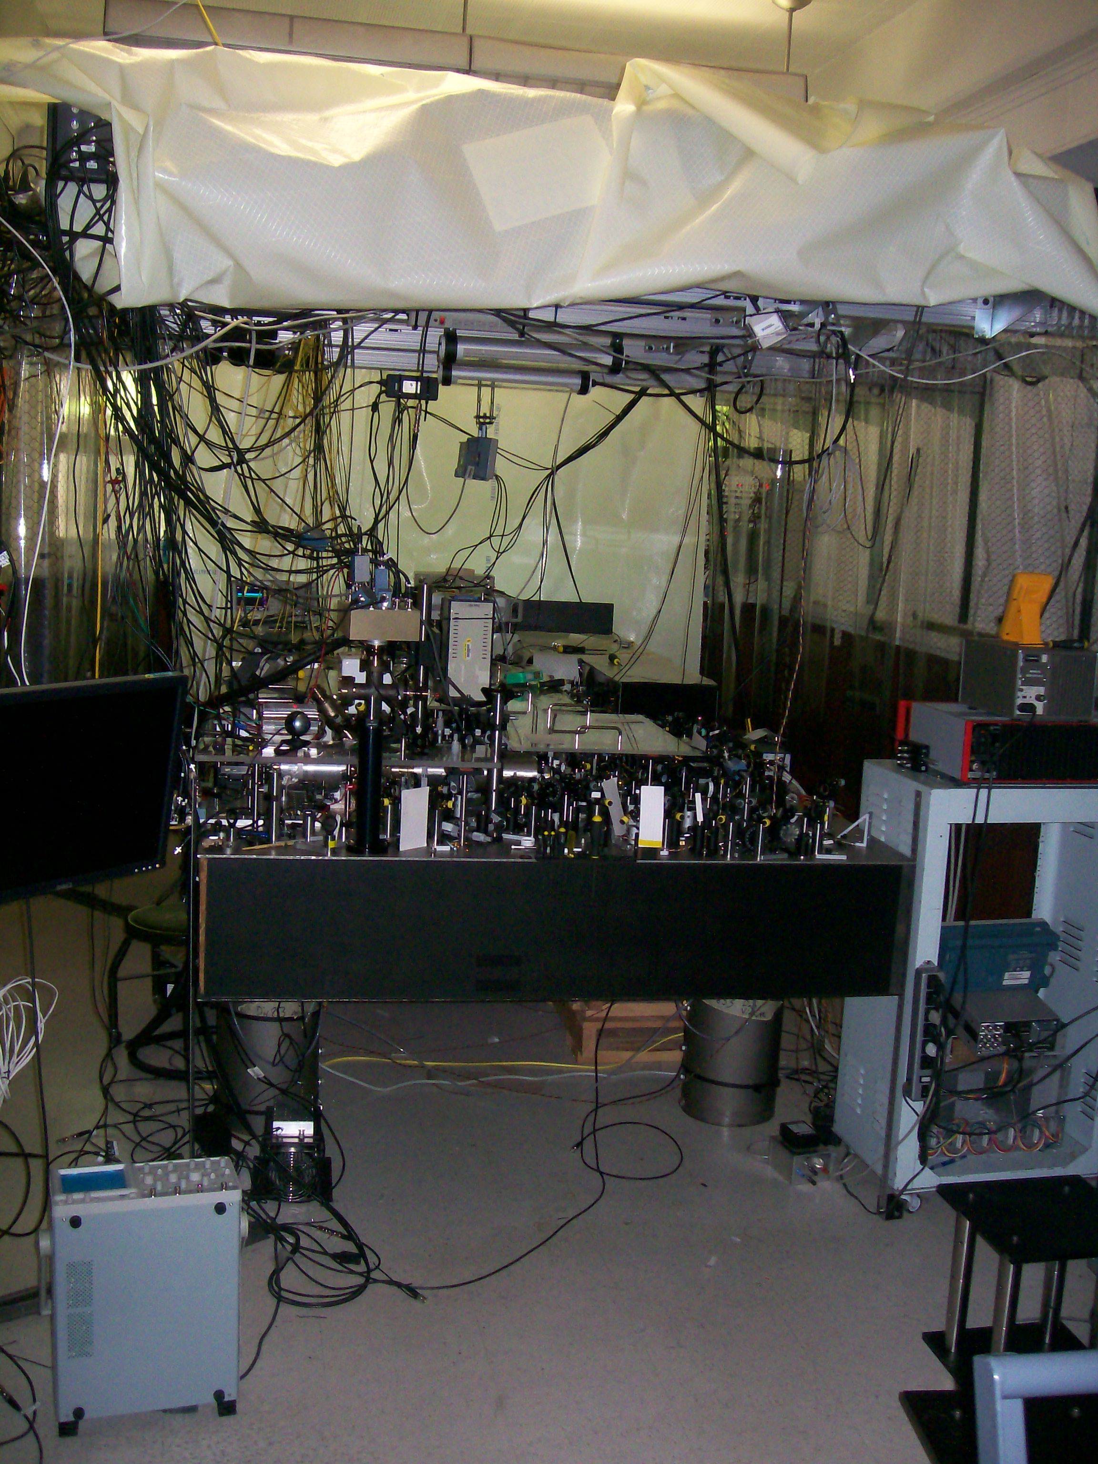
0 × 10⁻¹⁸
“portable” Al⁺ clock

Slide 16
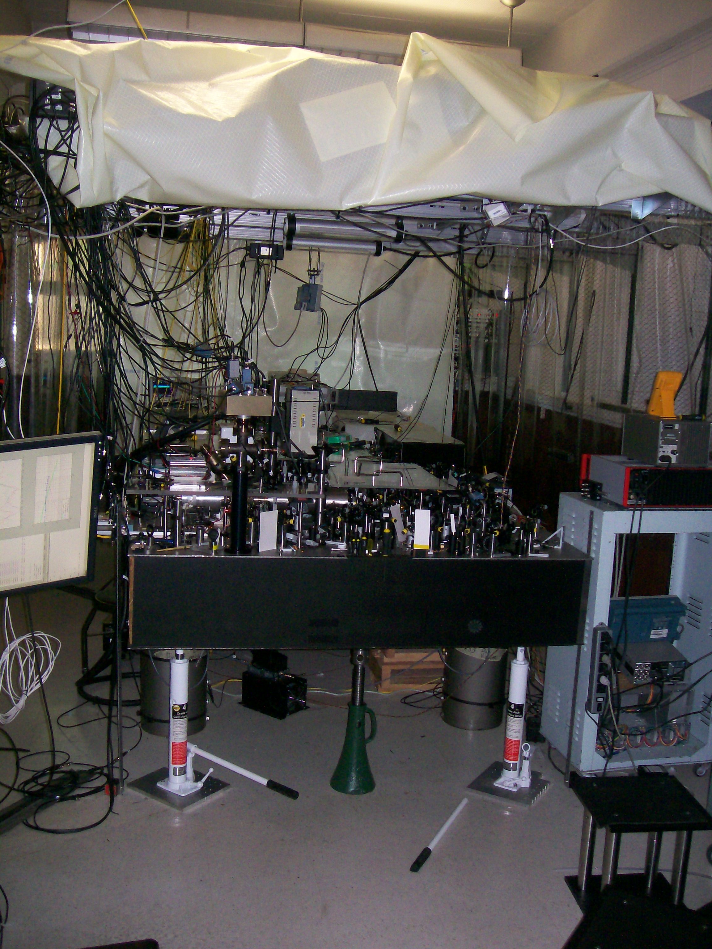
0 × 10⁻¹⁸

Slide 17
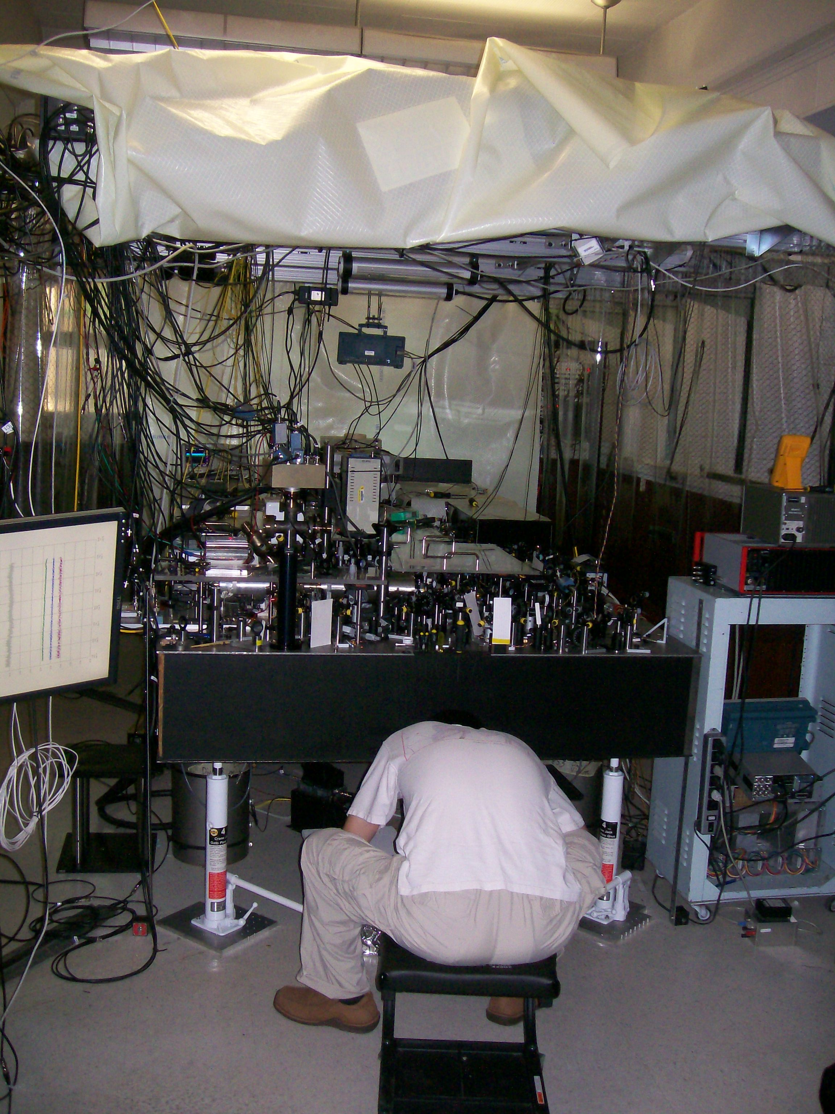
0 × 10⁻¹⁸

Slide 18
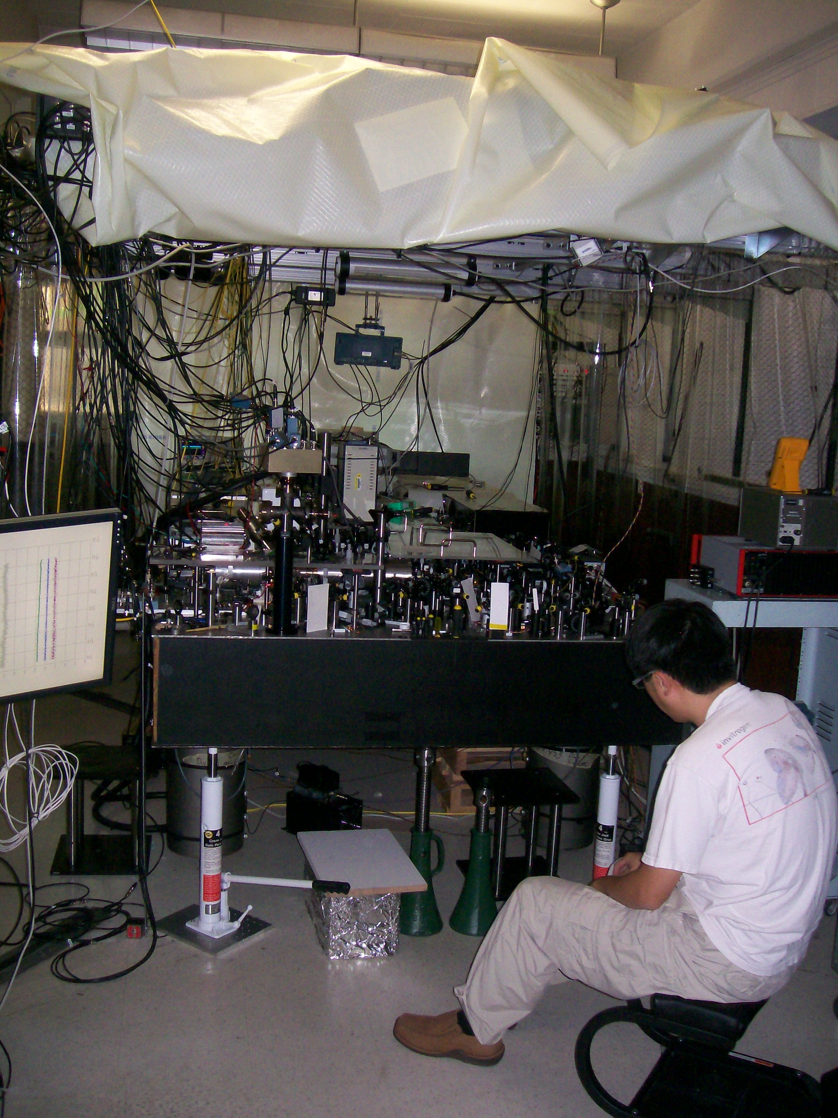
7 × 10⁻¹⁸

Slide 19
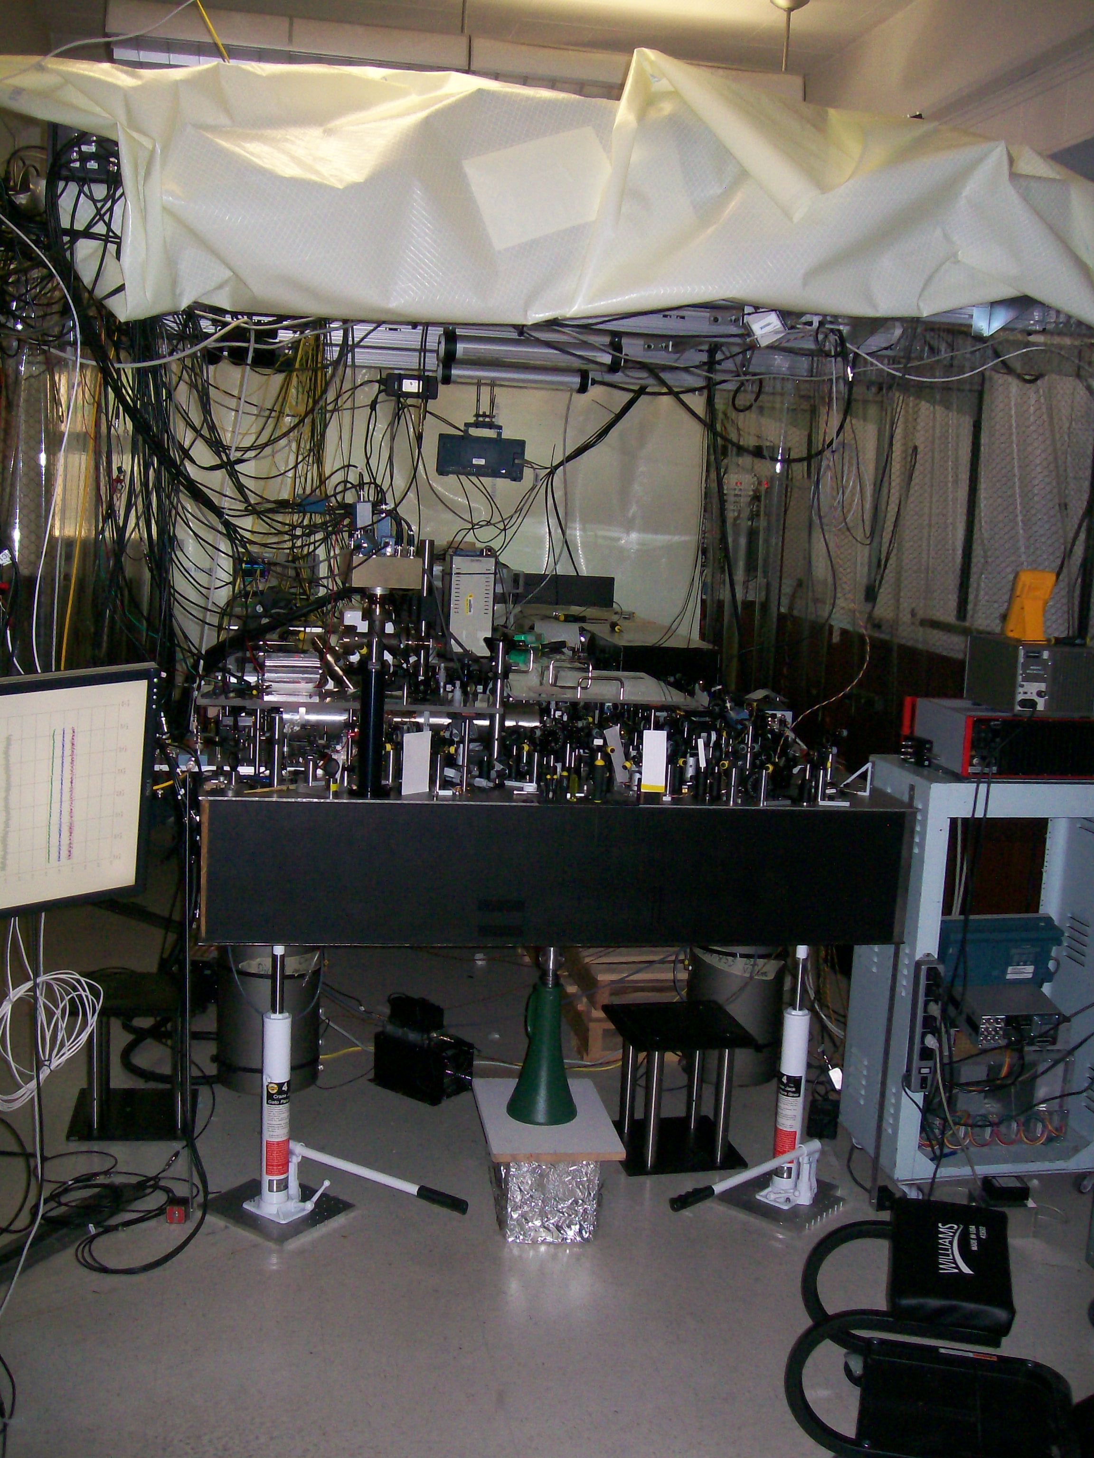
16 × 10⁻¹⁸

Slide 20
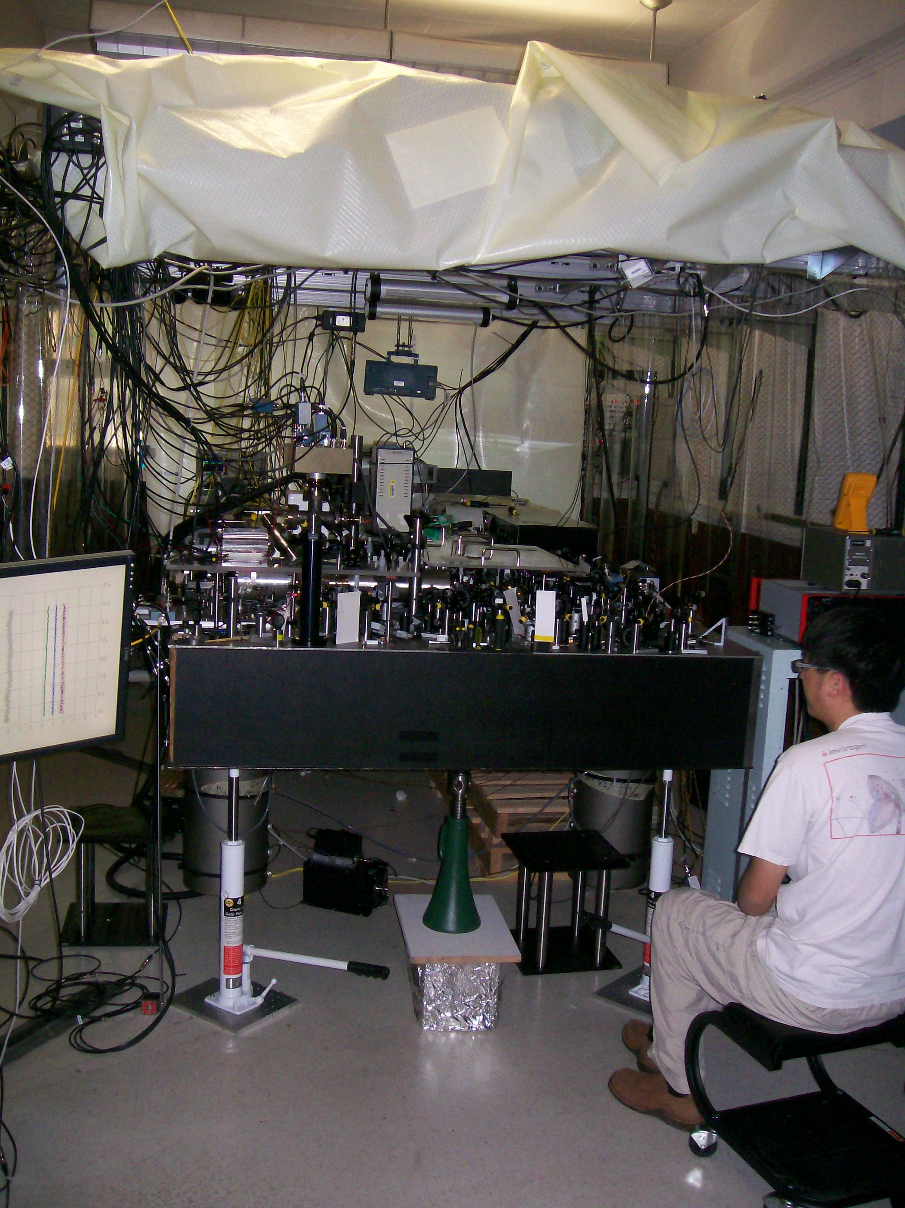
20 × 10⁻¹⁸

Slide 21
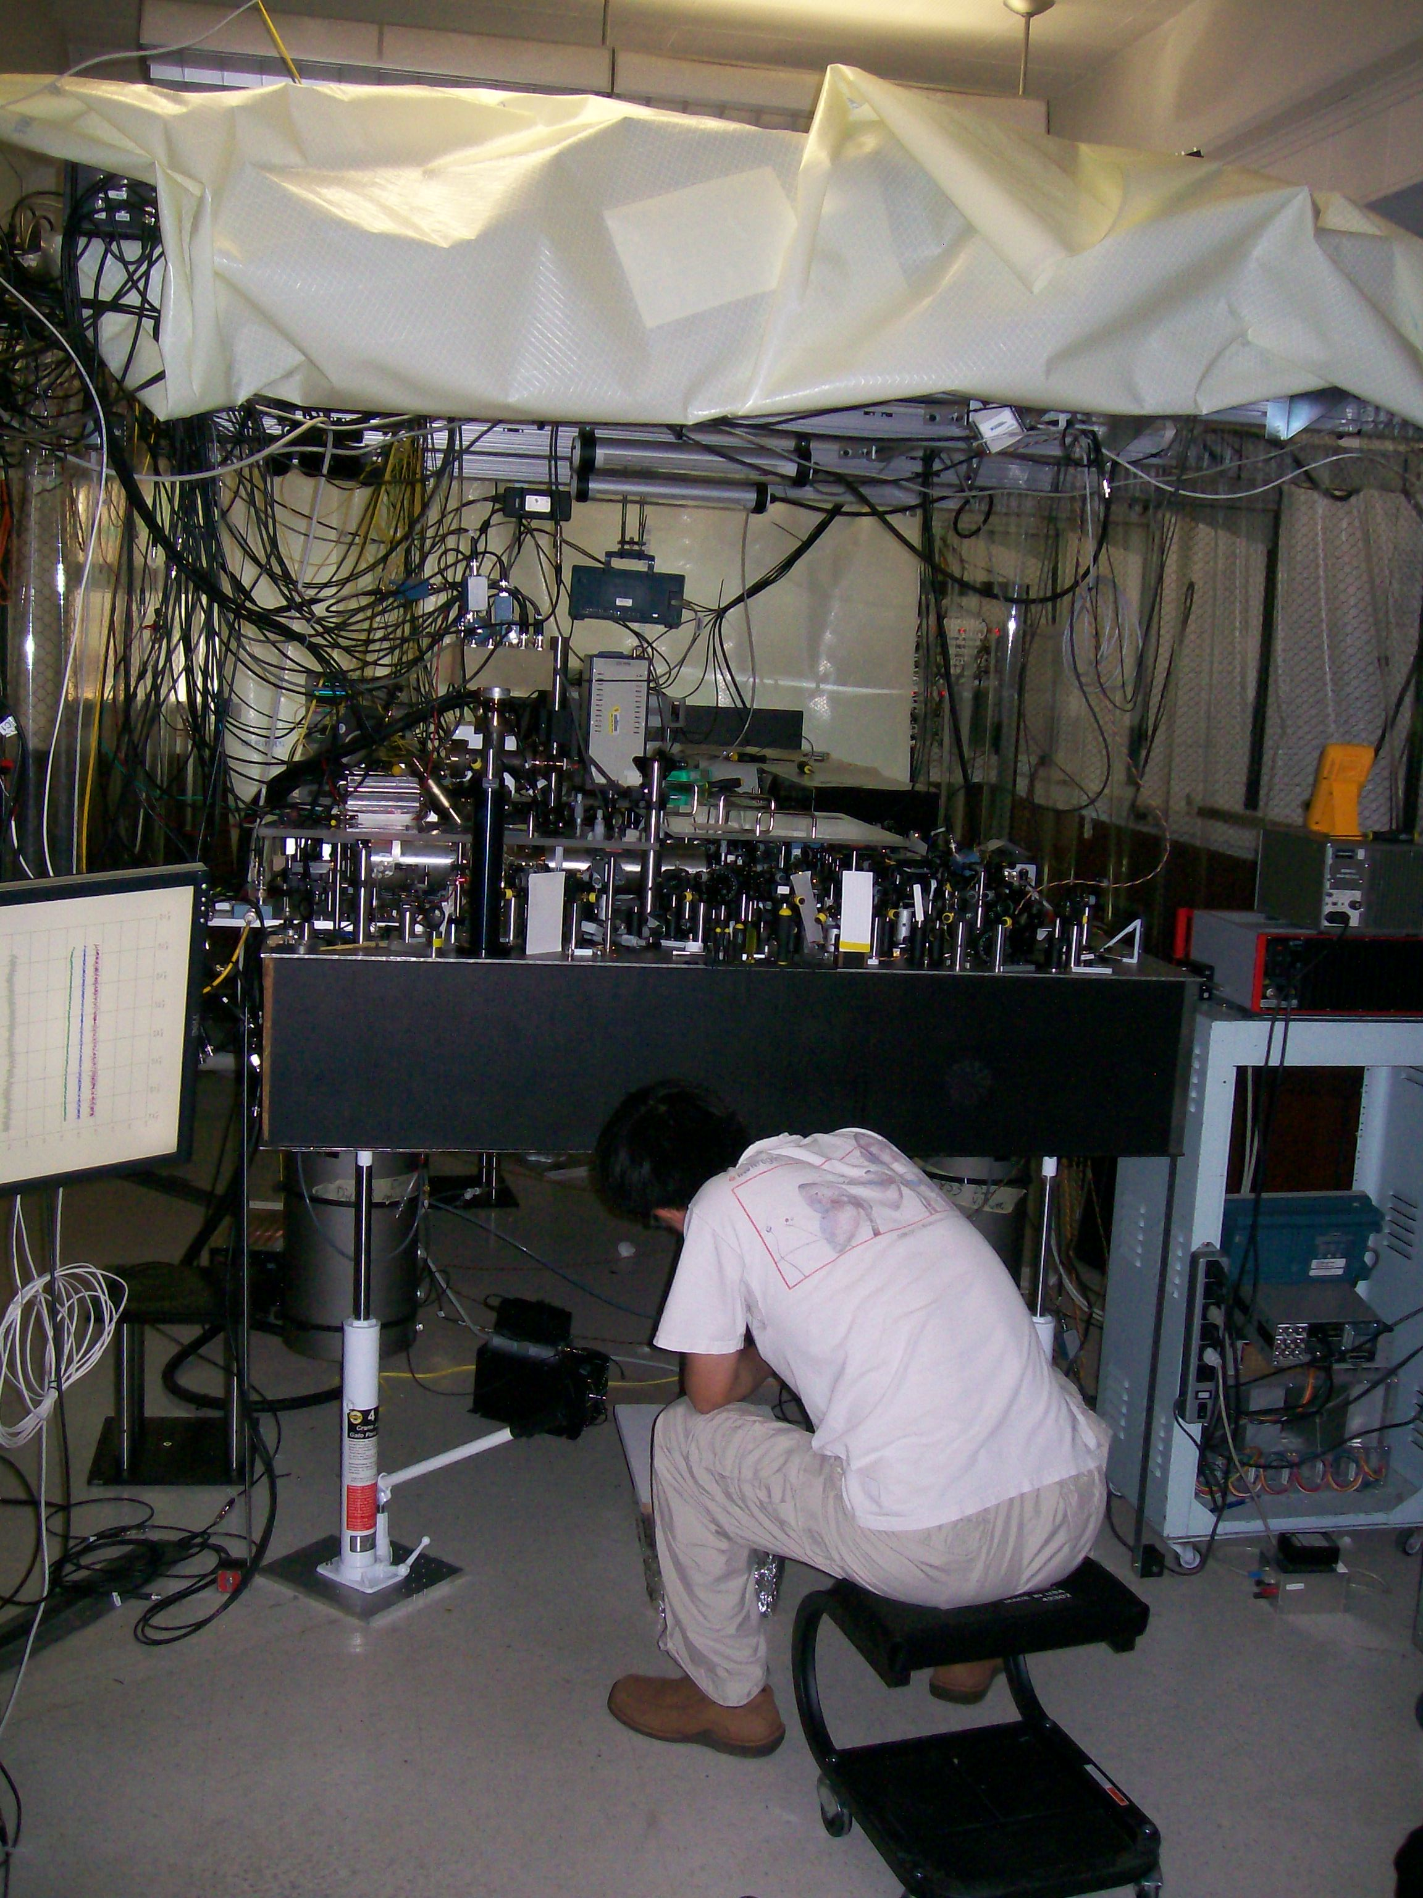
27 × 10⁻¹⁸

Slide 22
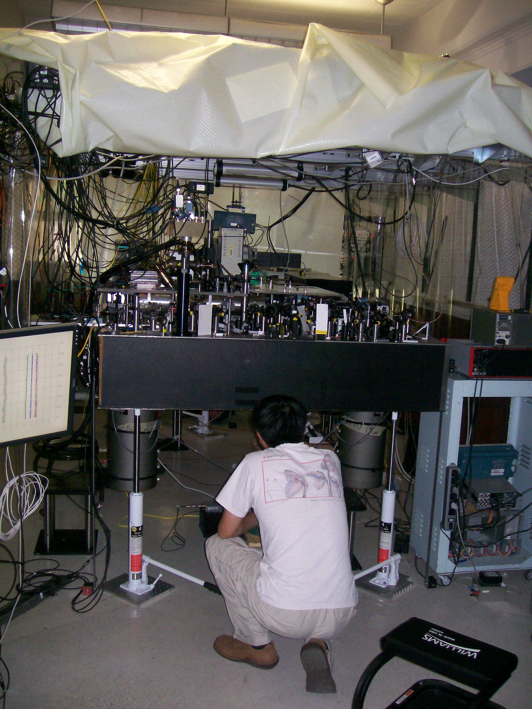
33 × 10⁻¹⁸

Slide 23
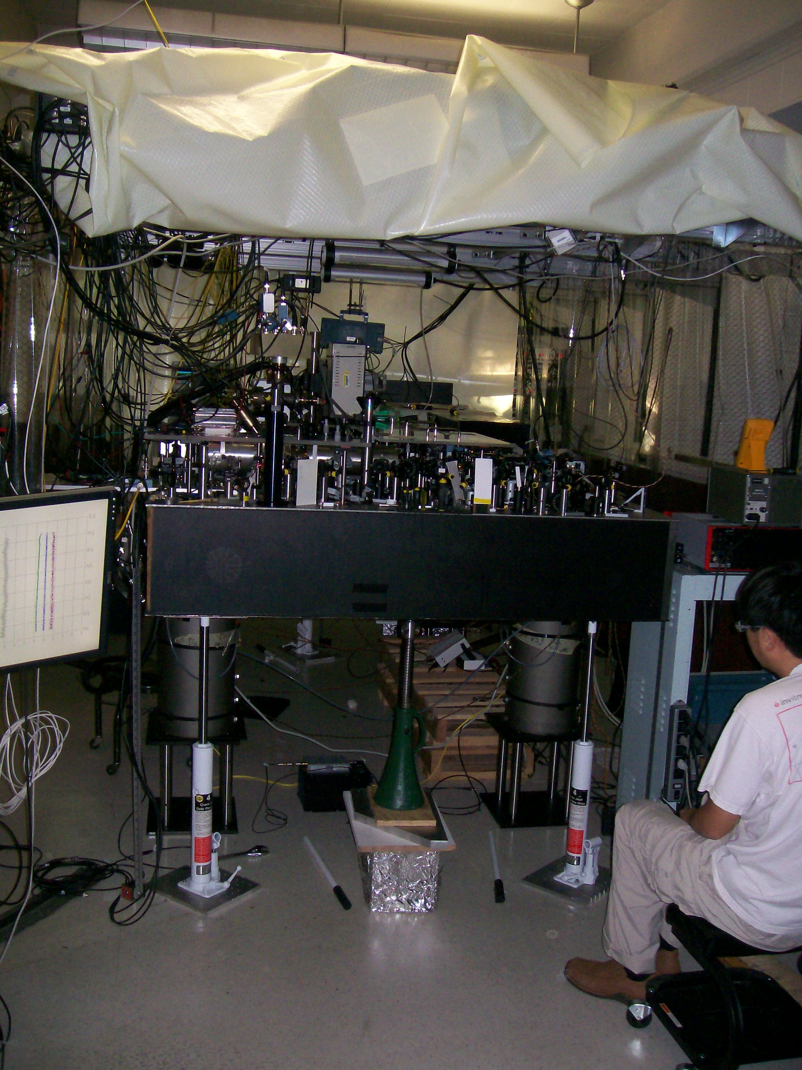
36 × 10⁻¹⁸

Slide 24
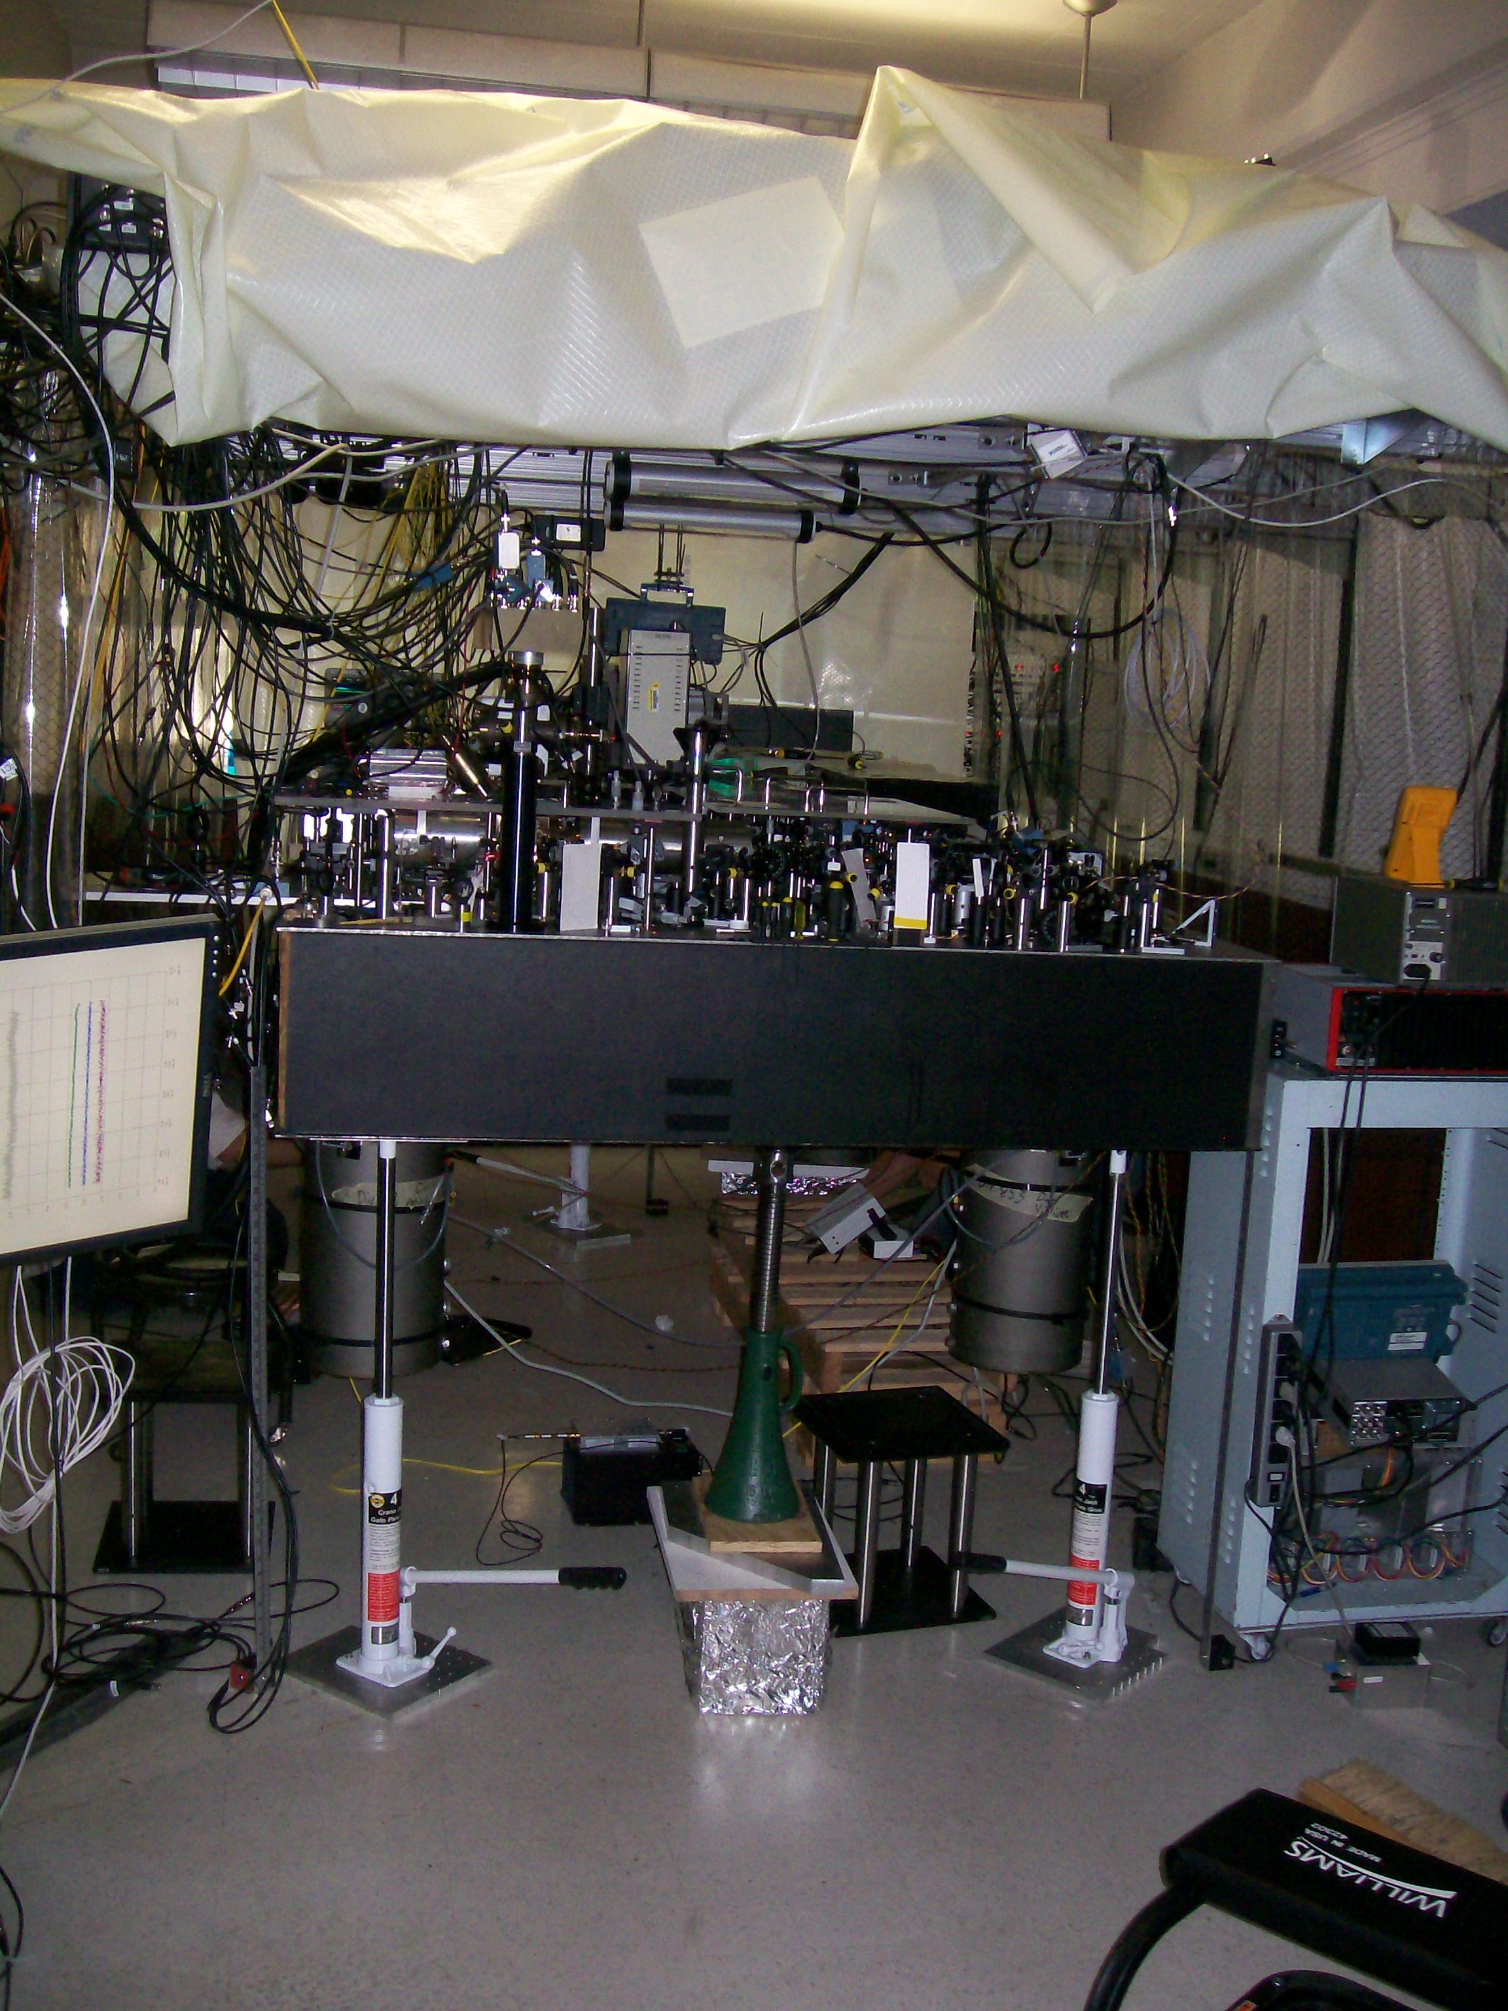
38 × 10⁻¹⁸

Slide 25
Δh = 33 cm
predict
36 × 10⁻¹⁸
measure
41 ± 16 x 10⁻¹⁸
C. W. Chou et al., Science 329, 1630 (2010)

Slide 26
Global spin-dependent force
F = F₀|↑⟩⟨↑| − F₀|↓⟩⟨↓|

Slide 27
Global spin-dependent force
|↑⟩
ADD: independent spin flips
|↓⟩
↓
↑
↓
↑
↓
↑
↓
↑
↓
↑
↓
↑
↓
↑
↓
↑
↓
↑
↓
↑
↓
↑
↓
↑
B
↓
↑
↓
↑
↓
↑
↓
↑
↓
↑
↓
↑
↓
↑
↓
↑
↓
↑
↓
↑
↓
↑
↓
↑
F = F₀|↑⟩⟨↑| − F₀|↓⟩⟨↓|

Slide 28
Global resonant spin-dependent force
carrier
lower
sidebands
upper
sidebands
Raman
beatnotes:
ω_{HF} ± μ
ω_{HF} (Δφ=π/2)
ω_{HF} −μ
ω_{HF}
ω_{HF}+μ
frequency
normal mode eigenvectors
(ion i mode m)
Ising
Couplings
0 < α < 3
control

Slide 29
Quantum simulations with trapped ions
A. Friedenauer, et al., Nature Phys. 4, 757 (2008)
K. Kim et al., Phys. Rev. Lett. 102, 250502 (2009)
K. Kim et al., Nature 465, 590 (2010)
E. Edwards et al., Phys. Rev. B 82, 060412 (2010)
J. Barreiro et al., Nature 470 , 486-491 (2011)
R. Islam, et al., Nature Comm. 2, 377 (2011)
B. Lanyon et al., Science 334, 57 (2011)
J. Britton et al., Nature 484, 489 (2012)
A. Khromova et al., PRL 108, 220502 (2012)
R. Islam, et al., Science 340, 583 (2013)
P. Richerme, et al., PRL 111, 100506 (2013)
P. Richerme, et al., PRA 88, 012334 (2013)
Porras and Cirac, PRL 92, 207901 (2004)
Deng, Porras, Cirac, PRA 72, 063407 (2005)
Taylor and Calarco, PRA 78, 062331 (2008)
from S. Lloyd,
Science 319,
1209 (2008)
Initialization:
Spins along y
Detection:
Measure spins along x
time

Slide 30
Antiferromagnetic Néel order of N=10 spins
2600 runs, α=1.12
All in state ↑
All in state ↓
AFM ground state order
222 events
219 events
441 events out of 2600 = 17%
Prob of any state at random =2 x (1/2¹⁰) = 0.2%
Notes:
Since we are able to image each ion individually using the camera, we can directly observe an increase in the number of excitations as we move to long-range afm interactions. For instance, with 10 spins, we can easily see the difference between when each of our spins is up and when each is down.
If we turn on our antiferromagnetic hamiltonian, we can then image our degenerate Neel ordered ground state. If we perform 2600 simulations of our AFM hamiltonian with a range of interaction parameterized by this alpha, we find
About 220 events for each of the ground states, or 17 percent probability of landing in the ground state. Compared to the probability of falling into these states at random, it’s clear that we’re still recovering some ground state character.
1:00 – 16:00

Slide 31
First Excited States
(Pop. ~1-2% each)
Notes:
Of course we can also look at the first excited states, that have a single defect like having two down spins next to each other, or two up spins, and find that they are not nearly as prevalent as the ground state, but still more populated than random chance would give.

Slide 32
Second Excited States
(Pop. ~1% each)

Slide 33
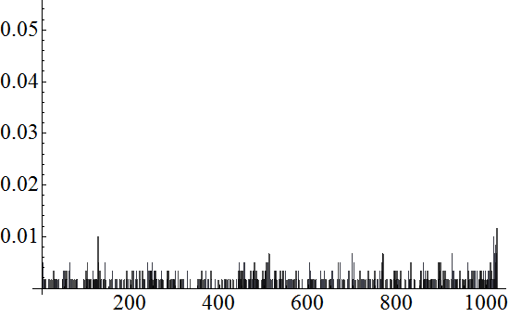
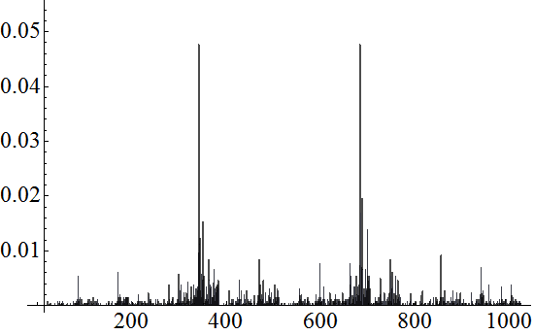
Distribution of all 2¹⁰ = 1024 states
Initial
paramagnetic
state
B >> J₀
Probability
0.10
0.08
0.06
0.04
0.02
0101010101
1010101010
Nominal
AFM
state
B << J₀
Probability
R. Islam et al.,
ArXiv 1210.0142
(to appear in Science)
0 341 682 1023
Notes:
In fact, using the camera we can look at the distribution of all 1024 possible states in the system. In the initial paramagnetic state, all possible spin configurations are roughly equally populated, save for a few detection errors.
When we ramp down the Hamiltonian, we see the two ground states popping out very clearly, each with about 9% probability, and the rest of the states suppressed.
:30 – 16:30

Slide 34
Distribution of states ordered by energy (N=10)
α = 1.12
α = 0.86
R. Islam et al., ArXiv 1210.0142 (to appear in Science)

Slide 35
Ion Trap Quantum Networks
Local connections through the
Coulomb interaction
Shuttling atoms through space
Nonlocal connections
with photons

Slide 36
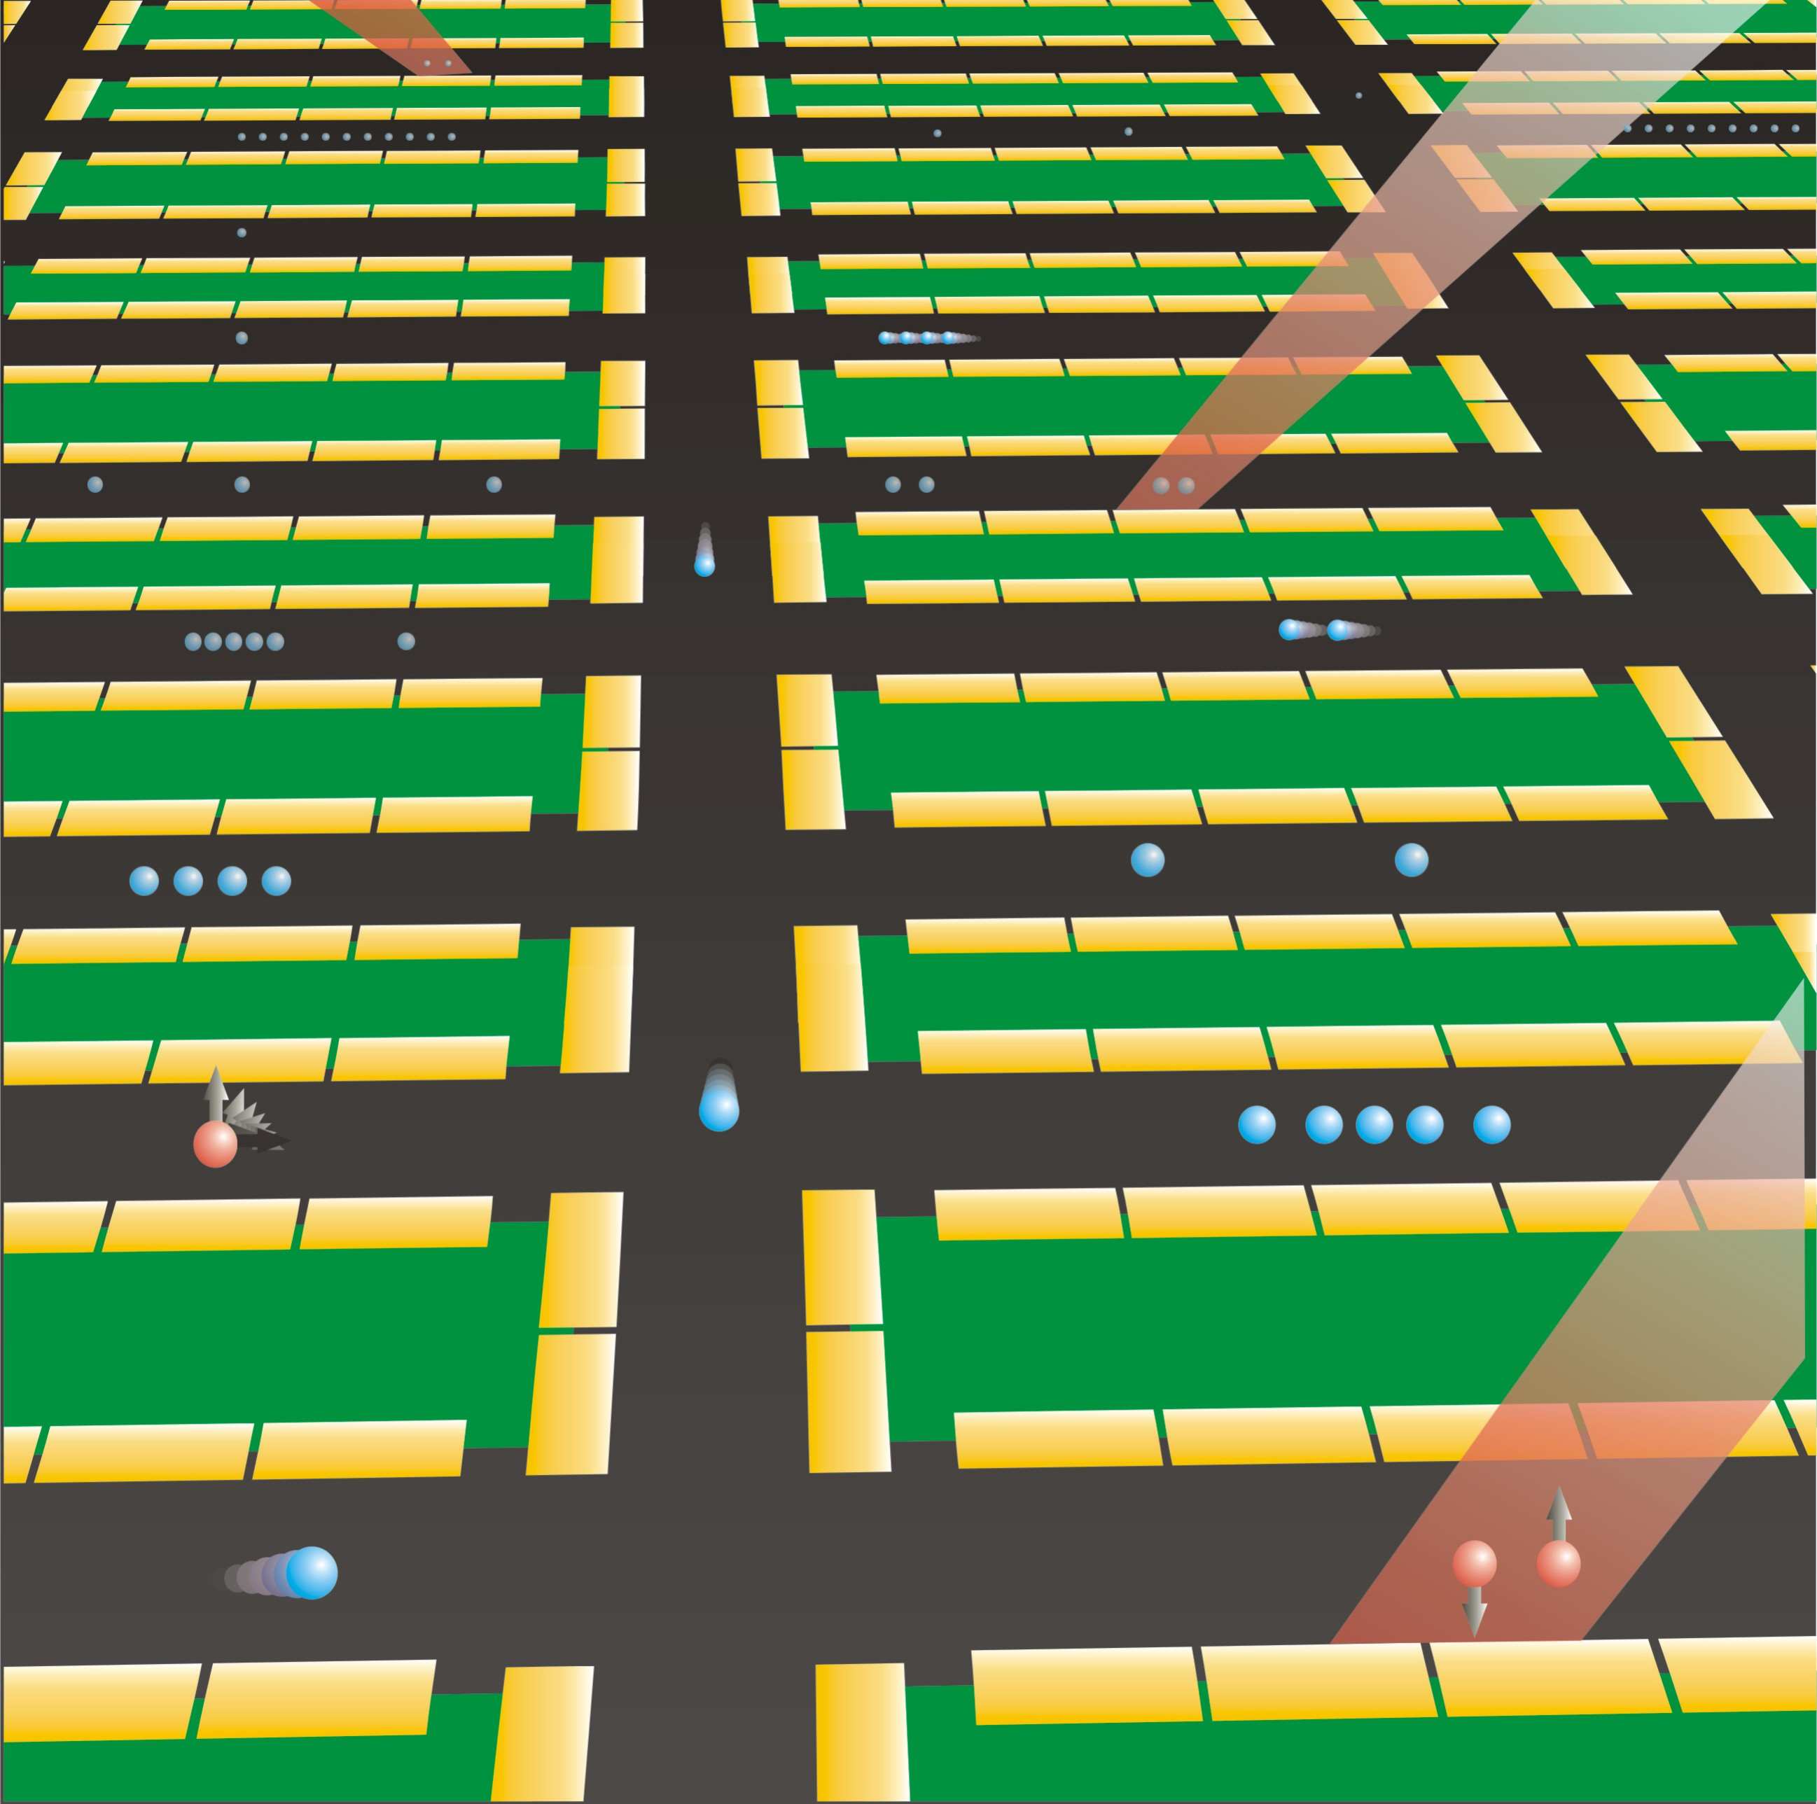
a (C.O.M.)
b (stretch)
Mode competition –
example: axial modes, N = 4 ions
c (Egyptian)
d (stretch-2)
60
b+c
d
c
mode
amplitudes
b
2b,a+c
a+b
c-a
b-a
2a
b-a
c-a
b+c
cooling beam
Fluorescence counts
a
a+b
2b,a+c
40
2a
d
carrier
a
b
axial modes only
c
20
-15
-10
-5
0
5
10
15
Raman Detuning δ_{R} (MHz)
D. Kielpinski, CM, D. Wineland, Nature 417, 709 (2002)

Slide 37
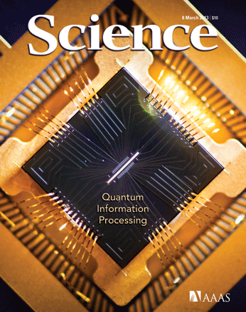
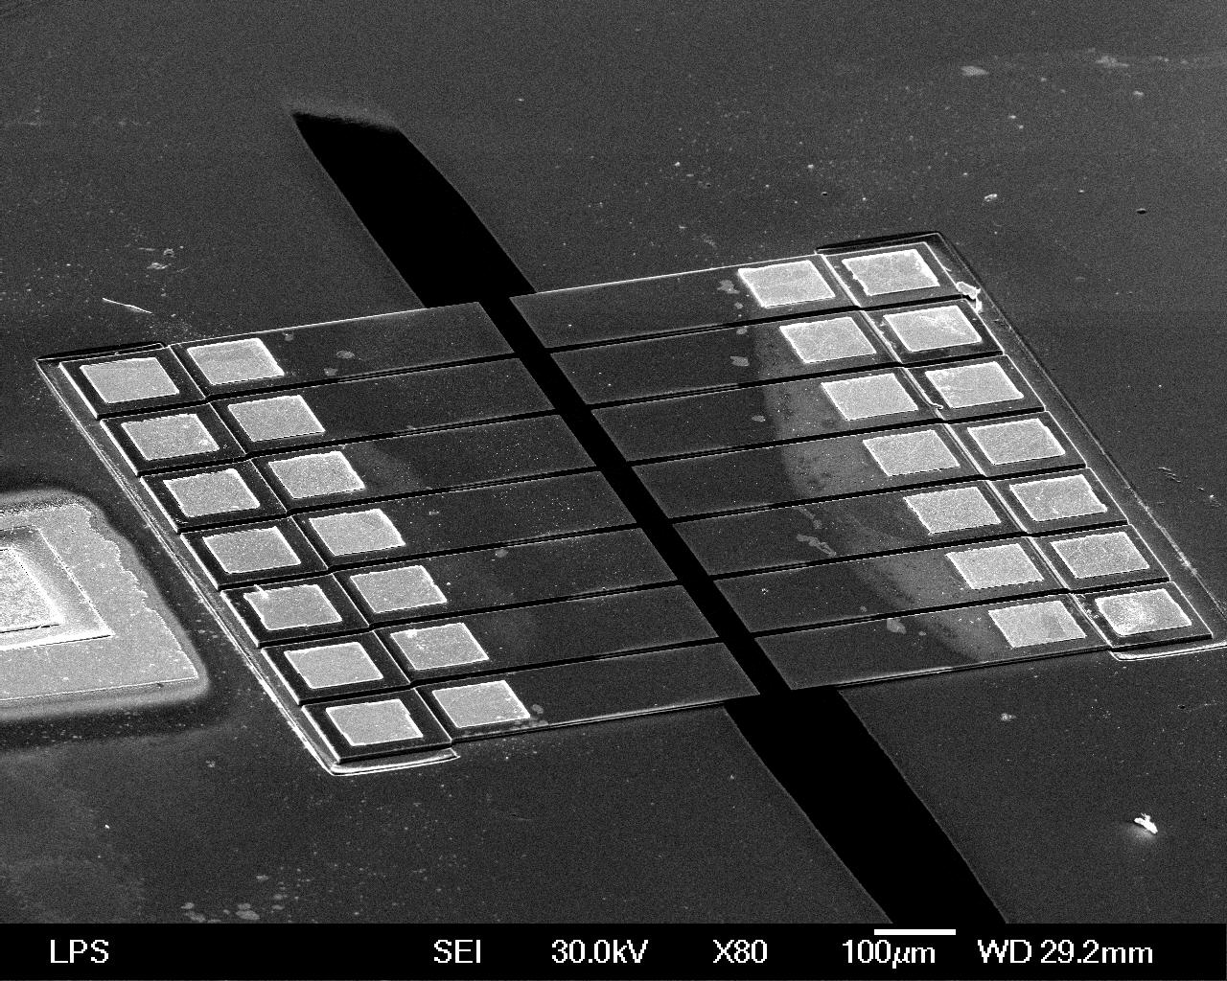
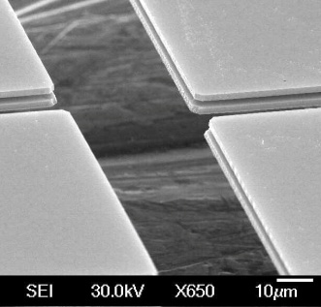
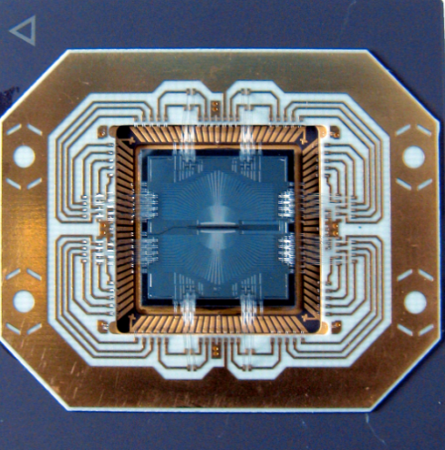
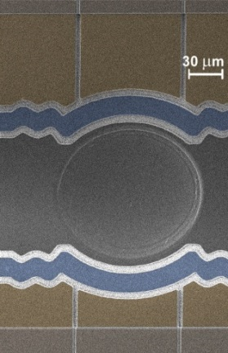
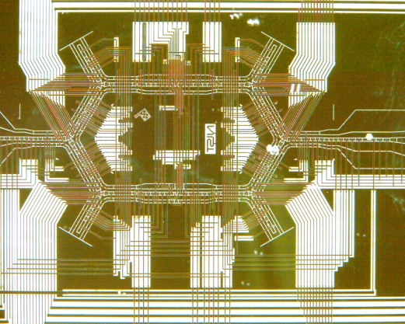
Univ. of
Maryland
Boulder

Slide 38
Ion Trap Quantum Networks
Local connections through the
Coulomb interaction
Shuttling atoms through space
Nonlocal connections
with photons

Slide 39
Linking remote atoms with photons
optical pump to S_{1/2} (0,0) (μsec)
promote to P_{1/2} (1,0) (psec)
wait for click(s)
μwaves (1,-1)→(0,0); (0,0) →(1,0); (1,1) →(0,0)
Given photon is collected
²P_{1/2}
|ψ⟩ = |↓⟩|−⟩ + |↑⟩|+⟩
(post-selected)
¹⁷¹Yb⁺
σ₊
σ₋
²S_{1/2}
2
|↑⟩
3
12 642 812 118 + 311B² Hz
1
μwaves
|↓⟩

Slide 40
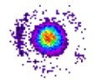
Linking remote atoms with photons
50/50
PBS
50/50
PBS
H₁
V₁
V₂
H₂
Heralded coincident events (p_{suc}=1/2):
(H₁ & V₂) or (V₁ & H₂) → |↓↑⟩ − |↓↑⟩
(H₁ & V₁) or (V₂ & H₂) → |↓↑⟩ + |↓↑⟩
(H₁ & H₁) or (H₂ & H₂) → |↓↓⟩
(V₁ & V₁) or (V₂ & V₂) → |↑↑⟩
50/50
BS
λ/4
λ/4
optical
fiber
Current:
¹⁷¹Yb⁺ ion
¹⁷¹Yb⁺ ion
Simon & Irvine, PRL 91, 110405 (2003)
L.-M. Duan, et. al., QIC 4, 165 (2004)
Y. L. Lim, et al., PRL 95, 030505 (2005)
D. Moehring et al., Nature 449, 68 (2007)

Slide 41
Linking remote atoms with photons
50/50
PBS
50/50
PBS
H₁
V₁
V₂
H₂
Heralded coincident events (p_{suc}=1/2):
(H₁ & V₂) or (V₁ & H₂) → |↓↑⟩ − |↓↑⟩
(H₁ & V₁) or (V₂ & H₂) → |↓↑⟩ + |↓↑⟩
(H₁ & H₁) or (H₂ & H₂) → |↓↓⟩
(V₁ & V₁) or (V₂ & V₂) → |↑↑⟩
50/50
BS
λ/4
λ/4
optical
fiber
Current:
¹⁷¹Yb⁺ ion
¹⁷¹Yb⁺ ion
Simon & Irvine, PRL 91, 110405 (2003)
L.-M. Duan, et. al., QIC 4, 165 (2004)
Y. L. Lim, et al., PRL 95, 030505 (2005)
D. Moehring et al., Nature 449, 68 (2007)
C. Hong, Z. Ou & L. Mandel, PRL 59, 2044 (1987)
C. Simon and W. Irvine, PRL 91, 110405 (2003)
D. Moehring, et al., Nature 449, 68 (2007)

Slide 42
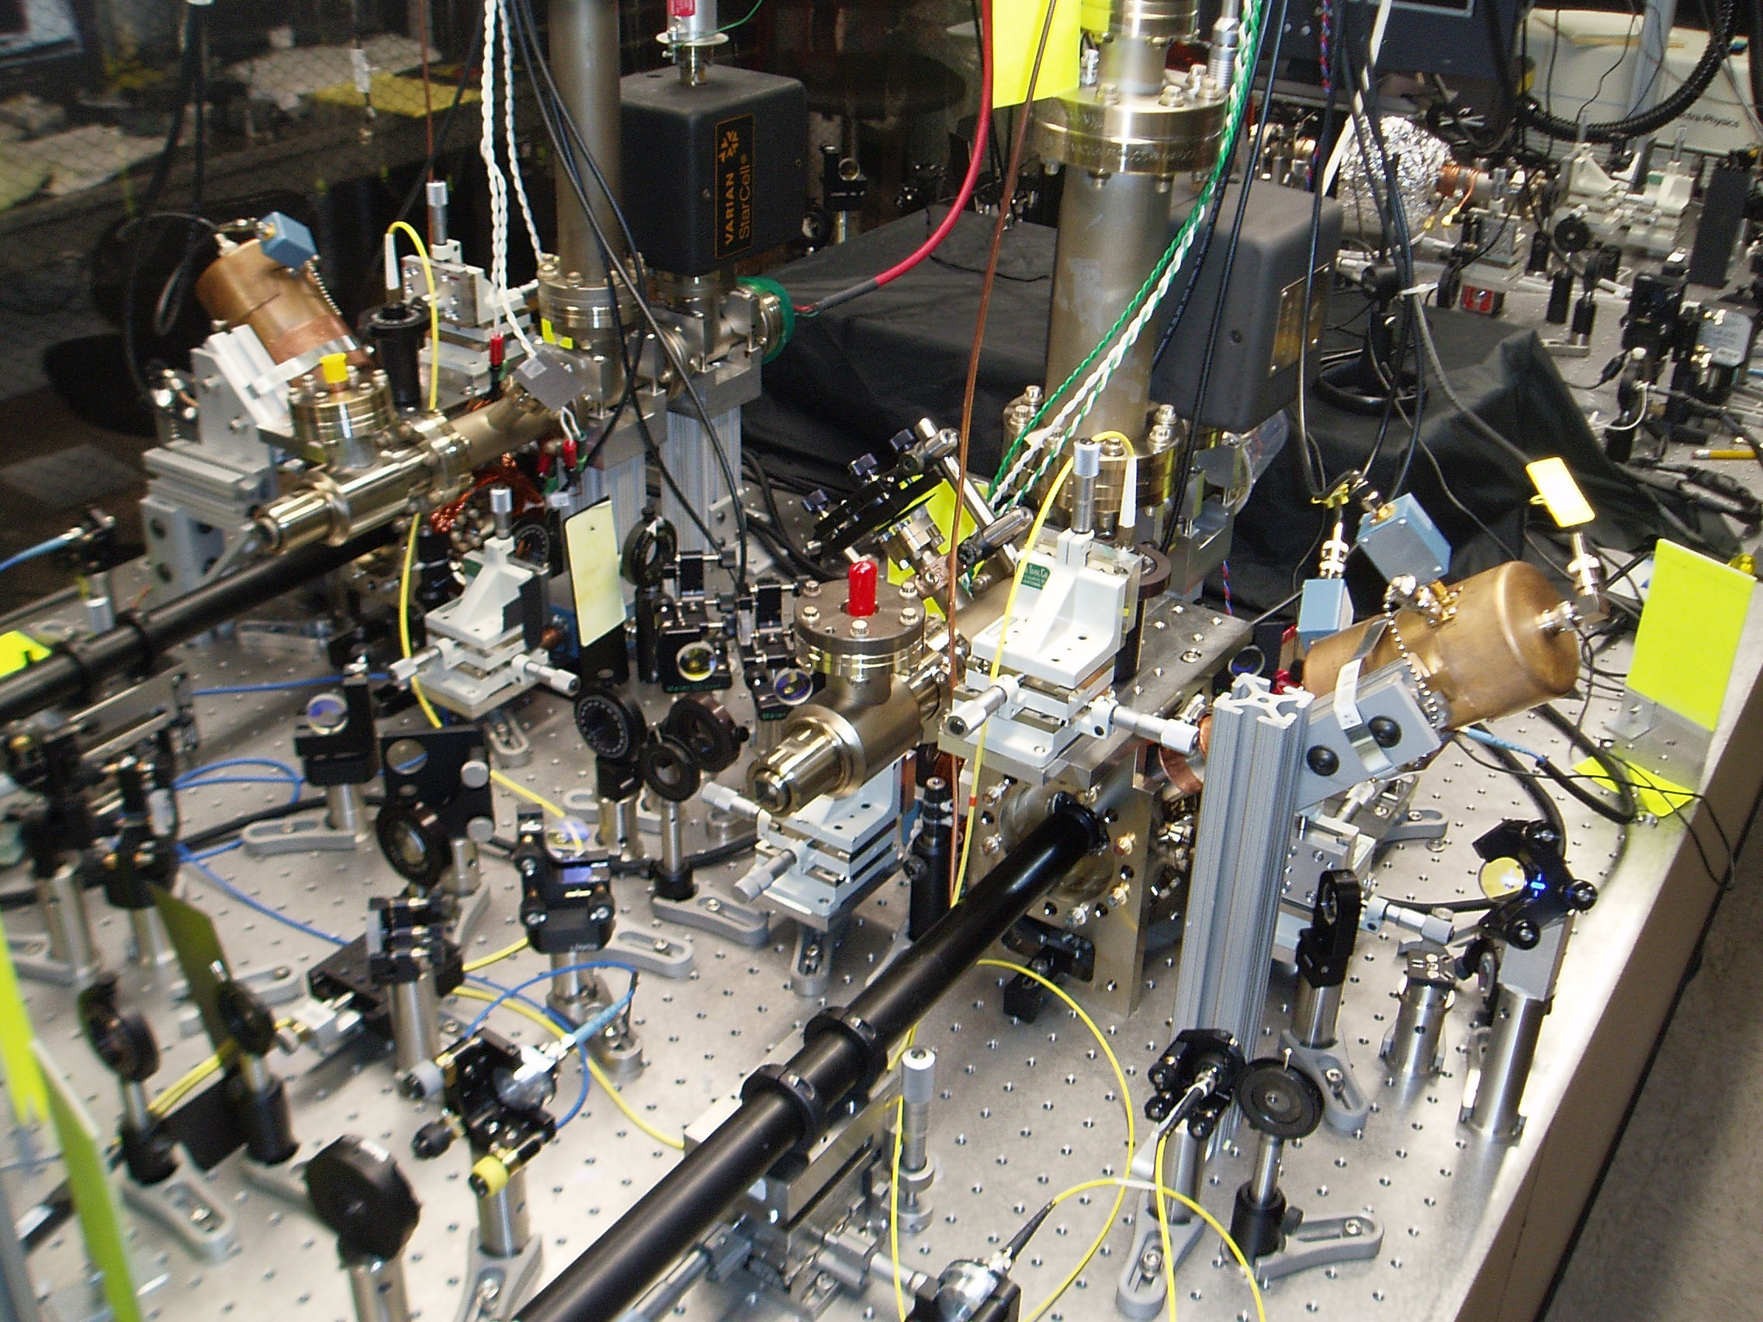
Quantum Teleportation
Detect coincident event:
α|↓⟩|↑⟩ − β|↑⟩|↓⟩
qubit uploaded to ion #1
α|↓⟩ + β|↑⟩
Measure
atom #1
|↑+↓⟩ or |↑−↓⟩
if |↑+↓⟩ then atom #2 in α|↑⟩ + β|↓⟩
if |↑−↓⟩ then atom #2 in α|↓⟩ − β|↑⟩
atom #2 in known state
|↓⟩ + |↑⟩
S. Olmschenk, et al., Science 323, 486 (2009)

Slide 43
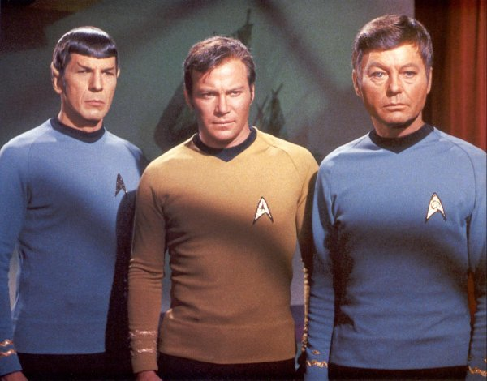
we need more atoms..
and more time

Slide 44
Integration of local gates with remote entanglement
State
↓↓↓
???
?(↓↑ − ↑↓)
(( ))
↓(↓↑ − ↑↓)
(↓↓ + ↑↑)↑ − (↓↑ − ↑↓)↓
3-particle entanglement
Fidelity ~ 85%
Rate ~ 2 Hz
1m

Slide 45
Hybrid quantum gate scheme
¹⁷¹Yb⁺
¹³⁸Ba⁺
Excite ¹³⁸Ba⁺ ion
(must repeat without disturbing ¹⁷¹Yb⁺)
Generate red photon
Execute swap gate between
¹³⁸Ba⁺ and ¹⁷¹Yb⁺
¹⁷¹Yb⁺ qubit entangled
with red photon
493.4nm
649.7nm
σ⁺/σ⁻
355nm
532nm
↑/↓
649.7nm
σ⁺/σ⁻

Slide 46
+

Slide 47
Large scale vision (10³ – 10⁶ atomic qubits?)
N collection
fibers
N/2 beam
splitters
N × N optical
crossconnect
switch
N trapped ion
quantum registers
CCD camera
C.M., et al., ArXiv 1208.0391 (2012)
Notes:
OPTICAL!!!

Slide 48
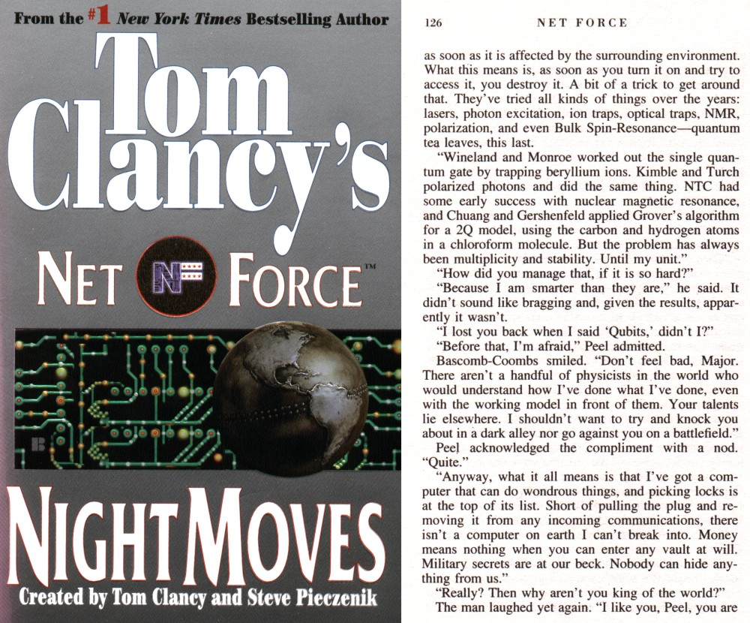
Notes:
Clancy’s Hero has figured out how to do it, he is “smarter than everyone else”
AND what makes QIS exciting is the smart people getting in the field, including young students from engineering etc..

Slide 49
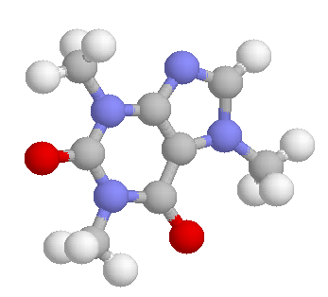
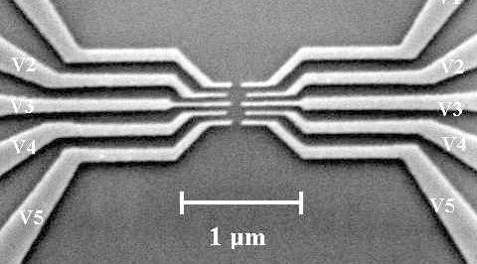
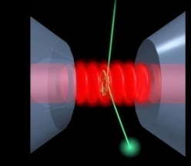
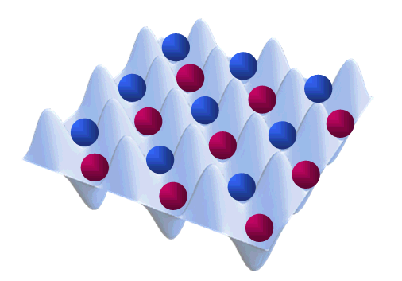
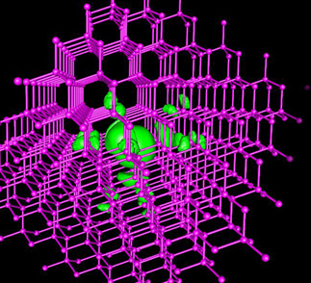
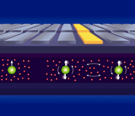
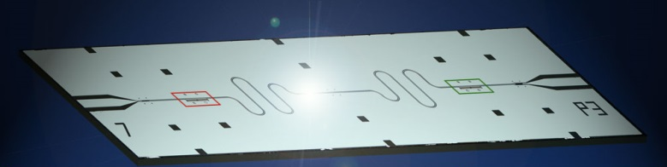
Quantum Information Hardware
Individual atoms and photons
trapped ions
atoms in optical lattices
cavity-QED
Semiconductors
quantum dots
2D electron gases
Other condensed-matter
single atomic defects in glass (NV-diamond)
single phosphorus atoms in silicon
Superconductors
Cooper-pair boxes (charge qubits)
rf-SQUIDS (flux qubits)
Notes:
Latt LeHaye
Britton Lourdes

Slide 50
Notes:
BUT MAYBE NOT THESE GUYS!
You may have heard about D-Wave, the company that claims to have already produced a quantum computer
They are learning, the hard way, that making a quantum system big is very difficult

Slide 51
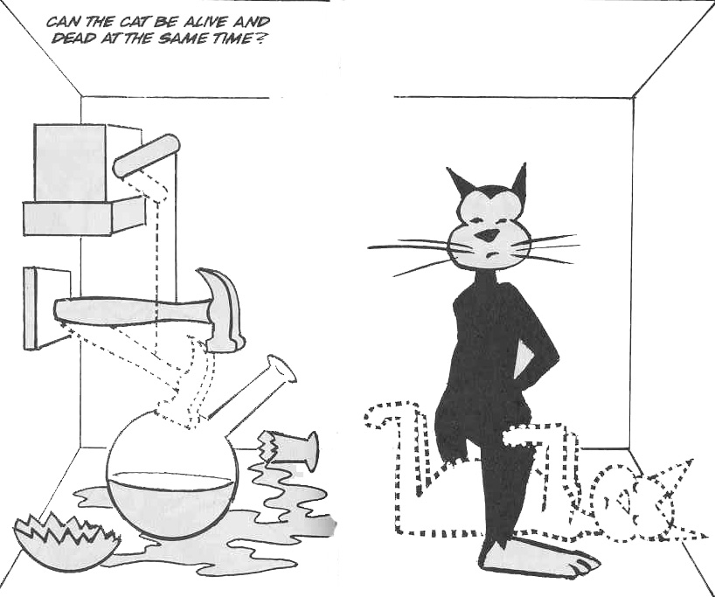
Schrödinger’s Cat (1935)
|did decay⟩ + |didn’t decay⟩
|Alive⟩ |Dead⟩
Notes:
Whatever the platform, we look to extend the reach of quantum systems..
To perhaps better understand the imaginary line between quantum and classical!

Slide 52
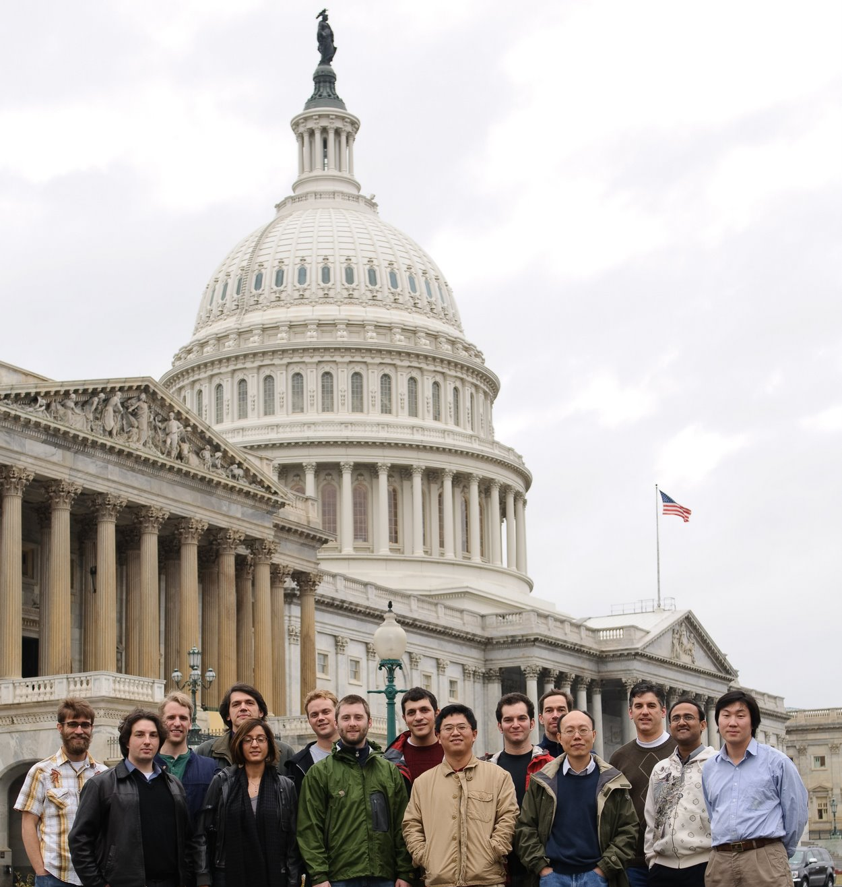
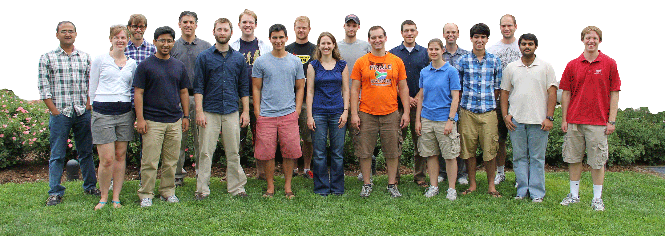
JOINT
QUANTUM
INSTITUTE
www.iontrap.umd.edu
Grad Students
David Campos
Clay Crocker
Shantanu Debnath
Caroline Figgatt
Dave Hayes (Sydney)
David Hucul
Volkan Inlek
Rajibul Islam (Harvard)
Aaron Lee
Kale Johnson
Simcha Korenblit
Andrew Manning
Jonathan Mizrahi
Crystal Senko
Jake Smith
Ken Wright
Postdocs
Susan Clark (Sandia)
Wes Campbell (UCLA)
Taeyoung Choi
Chenglin Cao
Brian Neyenhuis
Phil Richerme
Grahame Vittorini
Collaborators
Luming Duan
Howard Carmichael
Jim Freericks
Alexey Gorshkov
Undergrads
Daniel Brennan
Geoffrey Ji
Katie Hergenreder
NSA
ARO

