Slide 1
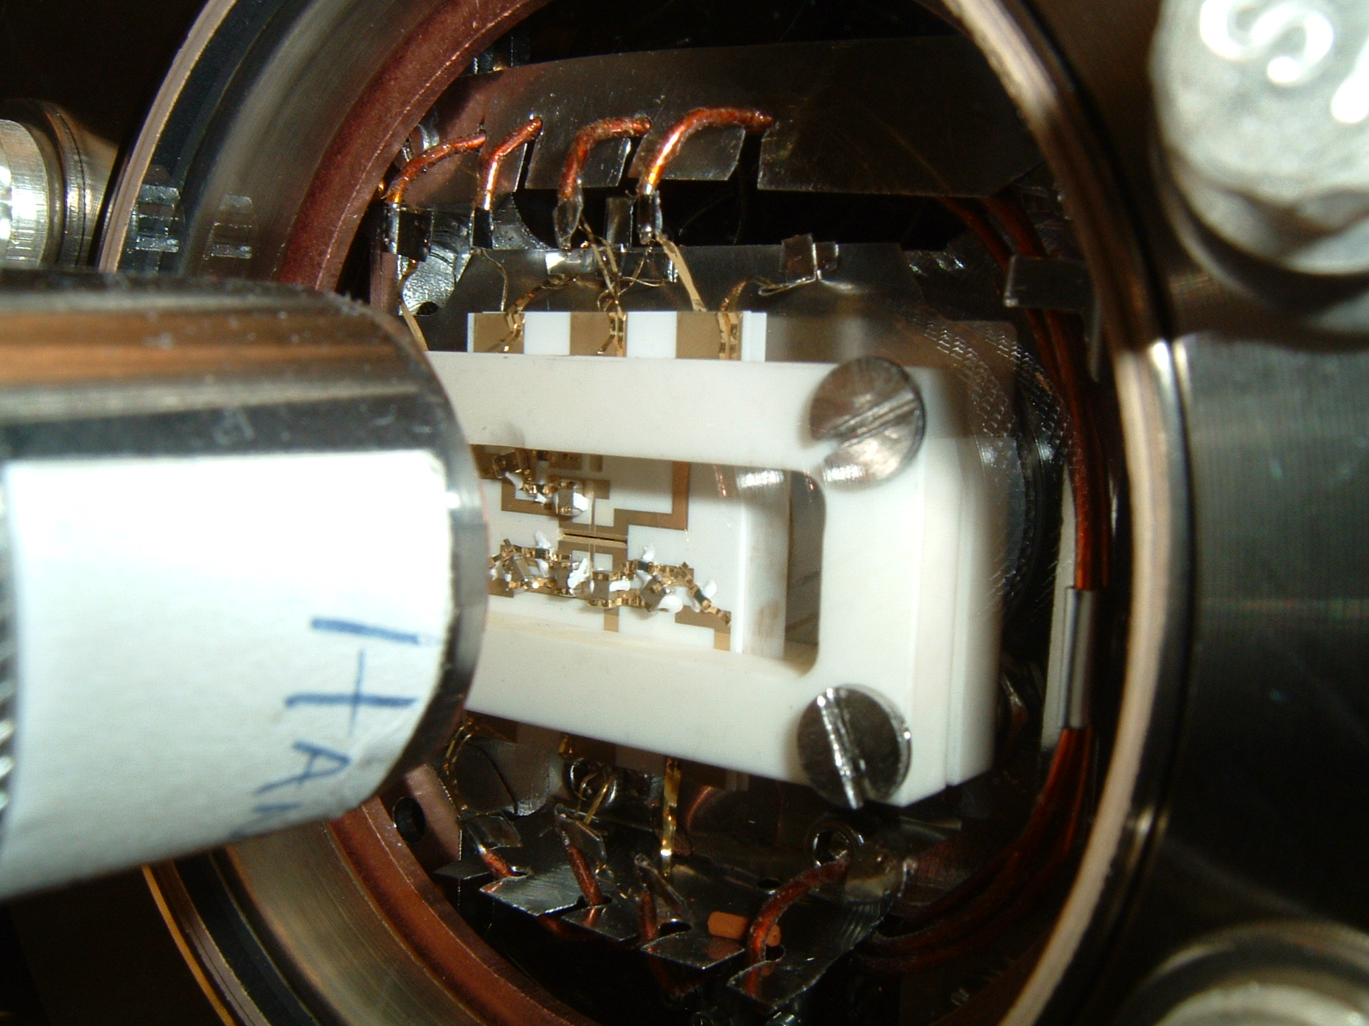
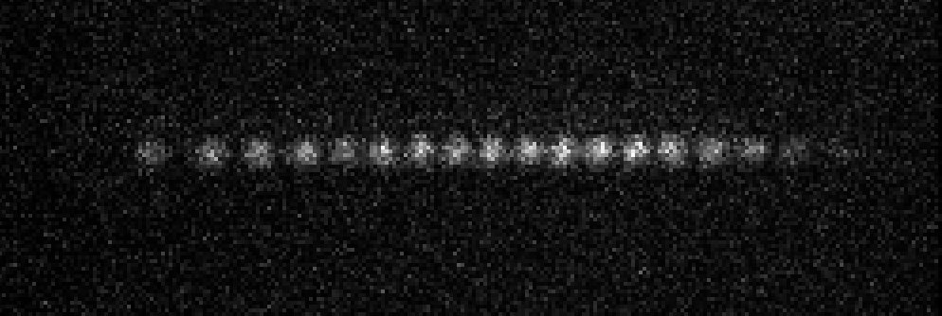
Quantum Simulations with
Trapped Atomic Ions
Yb⁺ crystal
~5 μm

Slide 2
global spin-dependent oscillating force
carrier
lower
sidebands
upper
sidebands
Raman
beatnotes:
ω_{HF} ± μ
ω_{HF} −μ
ω_{HF}+μ
frequency
†

Slide 3
†
evolution operator
†
phonons
interaction between qubits (entangling gates etc..)

Slide 4
“Adiabatically eliminate” phonons: |μ − ω_{k}| >> ηΩ₀ “SLOW MOLMER”
carrier
lower
sidebands
upper
sidebands
sideband
linewidth
=
μ
frequency
ω_{k}
General effective Hamiltonian theory:
D. F. James, Canadian J. Phys. 85, 625 (2007)

Slide 5
global spin-dependent oscillating force
carrier
lower
sidebands
upper
sidebands
Raman
beatnote:
μ
ω_{HF} ± μ
ω_{HF} (Δφ=π/2)
ω_{HF} −μ
ω_{HF}+μ
ω_{HF}
frequency
normal mode
eigenvectors
(ion i mode m)
Ising
Model
control

Slide 6
Quantum Simulation: What is it?
Ψ Describes N interacting systems, each system having D degrees of freedom
D^{N} coupled differential equations

Slide 7
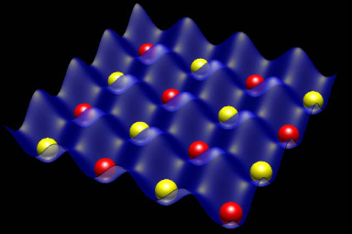
Two approaches
Physical
System
Ψ
(1)
Trial
H
Physical
System
Ψ
(2)
Choose
H

Slide 8
Quantum simulations with trapped ions
A. Friedenauer, et al., Nature Phys. 4, 757 (2008)
K. Kim et al., Phys. Rev. Lett. 102, 250502 (2009)
K. Kim et al., Nature 465, 590 (2010)
E. Edwards et al., Phys. Rev. B 82, 060412 (2010)
J. Barreiro et al., Nature 470 , 486-491 (2011)
R. Islam, et al., Nature Comm. 2, 377 (2011)
B. Lanyon et al., Science 334, 57 (2011)
J. Britton et al., Nature 484, 489 (2012)
A. Khromova et al., PRL 108, 220502 (2012)
R. Islam, et al., Science 340, 583 (2013)
P. Richerme, et al., ArXiv 1303.6983 (2013)
P. Richerme, et al., ArXiv 1305.2253 (2013)
Porras and Cirac, PRL 92, 207901 (2004)
Deng, Porras, Cirac, PRA 72, 063407 (2005)
Taylor and Calarco, PRA 78, 062331 (2008)

Slide 9
Frustration and
Entanglement
AFM
AFM
?
AFM
Spin Liquids

Slide 10
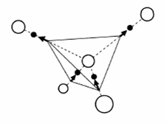
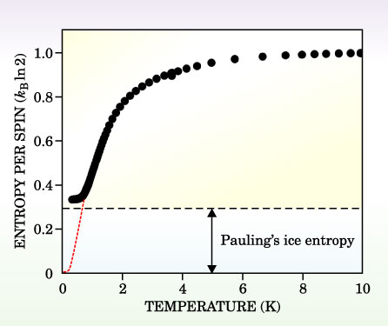
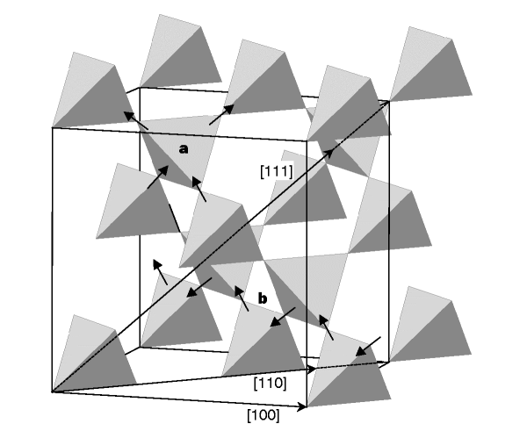
Ice
1936: Giauque and Stout, “The Entropy of Water and the Third Law of Thermodynamics. Heat Capacity of Ice from 15 to 273°K”
1945: L. Pauling The Nature of the Chemical Bond (Cornell Univ. Press), pp. 301-4
Zero-point entropy in 'spin ice’, A. P. Ramirez, A. Hayashi, R. J. Cava, R. Siddharthan and B. S. Shastry, Nature 399, 333 (1999)
(pyrochloric “spin ice” Dy₂Ti₂O₇)

Slide 11
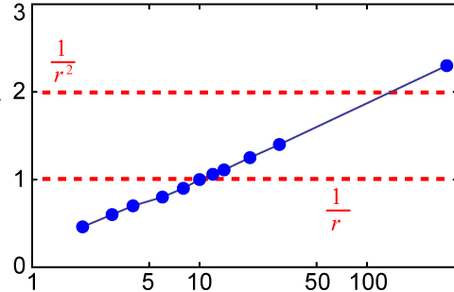
Control Range of Interaction!
Theory
Power Law Exponent α
tune
laser
here
tune
laser
here
Δω
μ−ω_{COM}
carrier
lower
sidebands
upper
sidebands
ω_{HF}
frequency

Slide 12
Adiabatic Quantum Simulation
Initialization
Cooling
Optical Pumping
Spins along y
(or against y)
Detection
Measure each spin along x
time

Slide 13
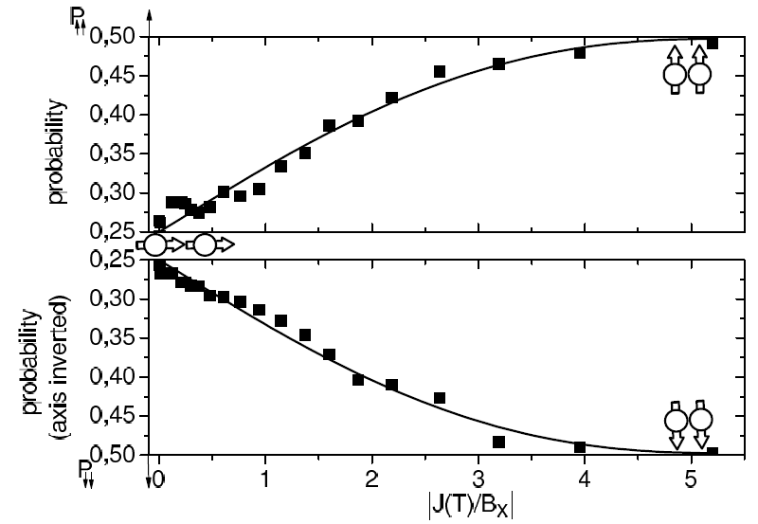
N=2
A. Friedenauer, et al., Nature Phys. 4, 757 (2008)

Slide 14
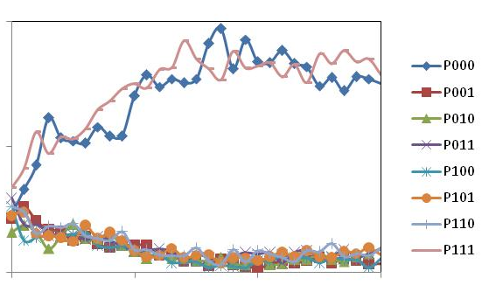
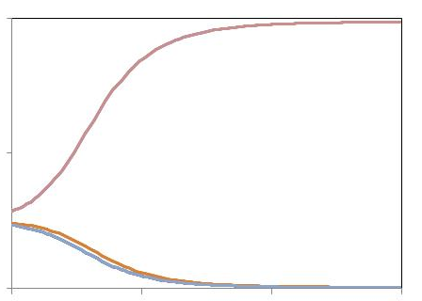
N=3
Initialization
Cooling
Optical Pumping
Spins along y
Detection
Measure each spin along x
time
Measured Populations
Exact Ground State
0.50
0.25
0.00
0.50
0.25
0.00
P↓↓↓
P↓↓↑
P↓↑↓
P↓↑↑
P↑↓↓
P↑↓↑
P↑↑↓
P↑↑↑
P↓↓↓, P↑↑↑
J₁₂=J₁₃=J₂₃ < 0
0 100 200 300
0 100 200 300
τ (μs)
τ (μs)
10
B/J_{rms}
0.2
10
B/J_{rms}
0.2
E. Edwards, et al., Phys. Rev. B 82, 060412 (2010)

Slide 15
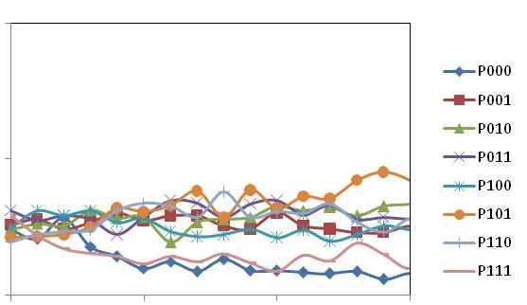
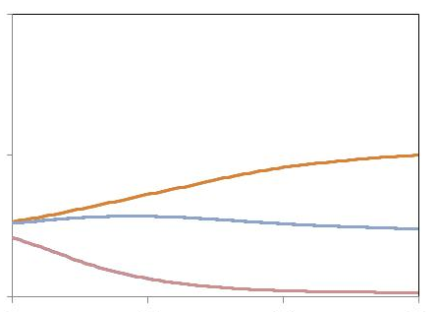
N=3
Initialization
Cooling
Optical Pumping
Spins along y
Detection
Measure each spin along x
time
Measured Populations
Exact Ground State
0.50
0.25
0.00
0.50
0.25
0.00
P↓↓↓
P↓↓↑
P↓↑↓
P↓↑↑
P↑↓↓
P↑↓↑
P↑↑↓
P↑↑↑
J₁₂=J₁₃=J₂₃ > 0
P↓↓↓, P↑↑↑
0 100 200 300
0 100 200 300
τ (μs)
τ (μs)
10
B/J_{rms}
0.2
10
B/J_{rms}
0.2
E. Edwards, et al., Phys. Rev. B 82, 060412 (2010)

Slide 16
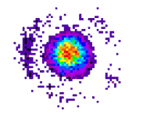
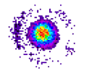
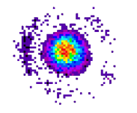
N=3
Ferromagnetic couplings
J₁₂=J₁₃=J₂₃ < 0
FM
FM
FM
ground state is entangled
B_{x}=0
|Ψ⟩ = |↑↑↑⟩+|↓↓↓⟩
symmetry
breaking
field B_{x}
P₀ P₁ P₂ P₃
B_{x}≠0
|Ψ₁⟩ = |↑↑↑⟩
no entanglement
|Ψ₂⟩ = |↓↓↓⟩
no entanglement
P₀ P₁ P₂ P₃
K. Kim, et al., Nature 465, 590 (2010)

Slide 17
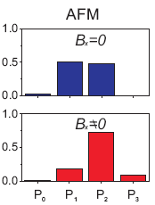
N=3
Competing AFM:
spin frustration
J₁₂=J₁₃=J₂₃ > 0
AFM
AFM
?
AFM
ground state is entangled
B_{x}=0
|Ψ⟩ = |↑↑↓⟩ +|↑↓↑⟩+|↓↑↑⟩ +|↑↓↓⟩ +|↓↑↓⟩+|↓↓↑⟩
symmetry
breaking
field B_{x}
P₀ P₁ P₂ P₃
B_{x}≠0
|Ψ₁⟩ = |↑↑↓⟩ +|↑↓↑⟩+|↓↑↑⟩
still entangled!
|Ψ₂⟩ = |↑↓↓⟩ +|↓↑↓⟩+|↓↓↑⟩
still entangled!
P₀ P₁ P₂ P₃
Frustration ⇔ Entanglement
K. Kim, et al., Nature 465, 590 (2010)

Slide 18
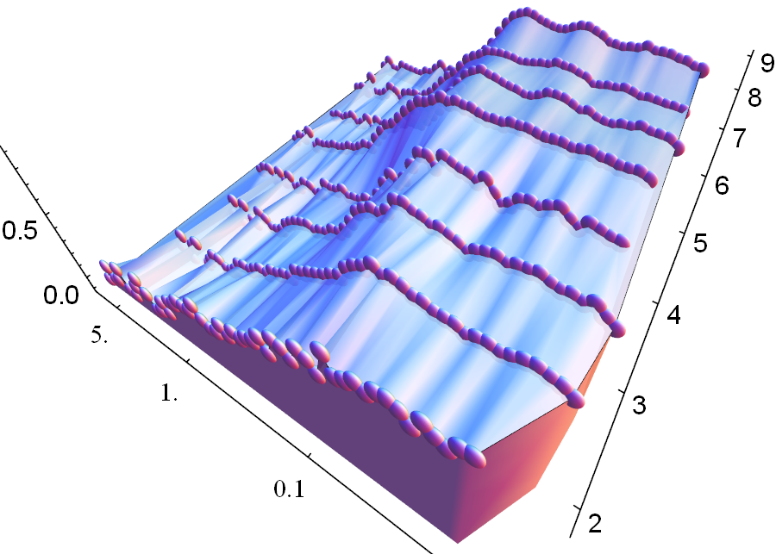
Emergence of ferromagnetism vs. # spins N
(all FM couplings: J_{ij}<0)
|m_{x}|
N
0
0.25
t(ms)
B/|J|
0.5
R. Islam et al., Nature Communications 2, 377 (2011)

Slide 19
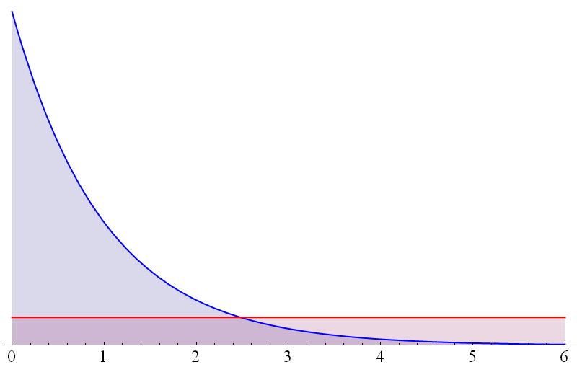
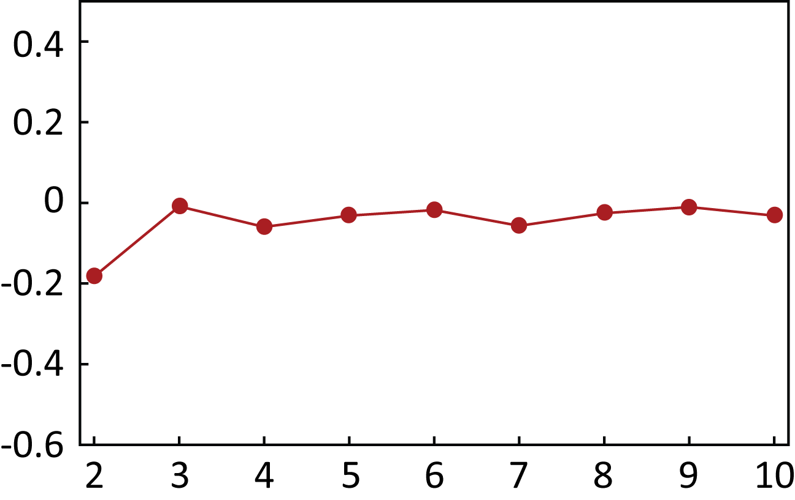
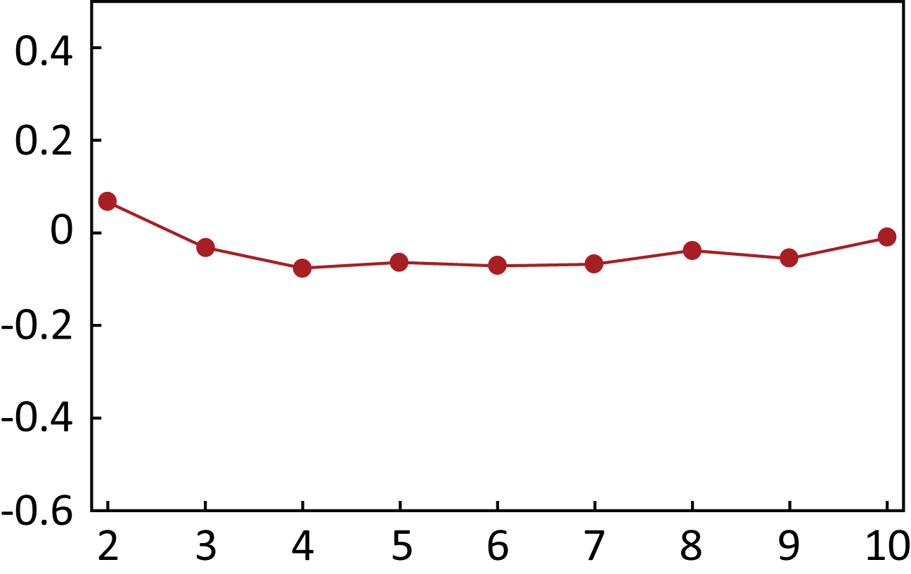
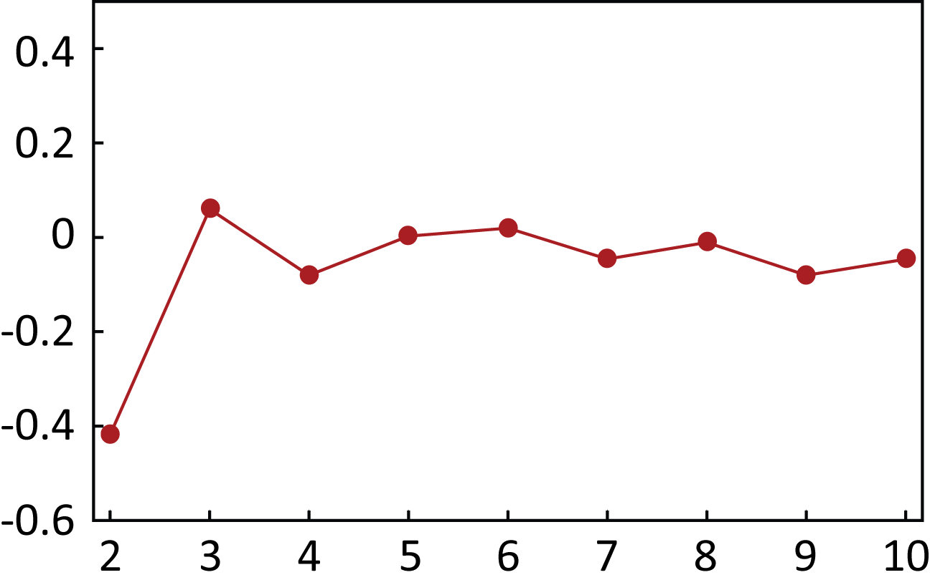
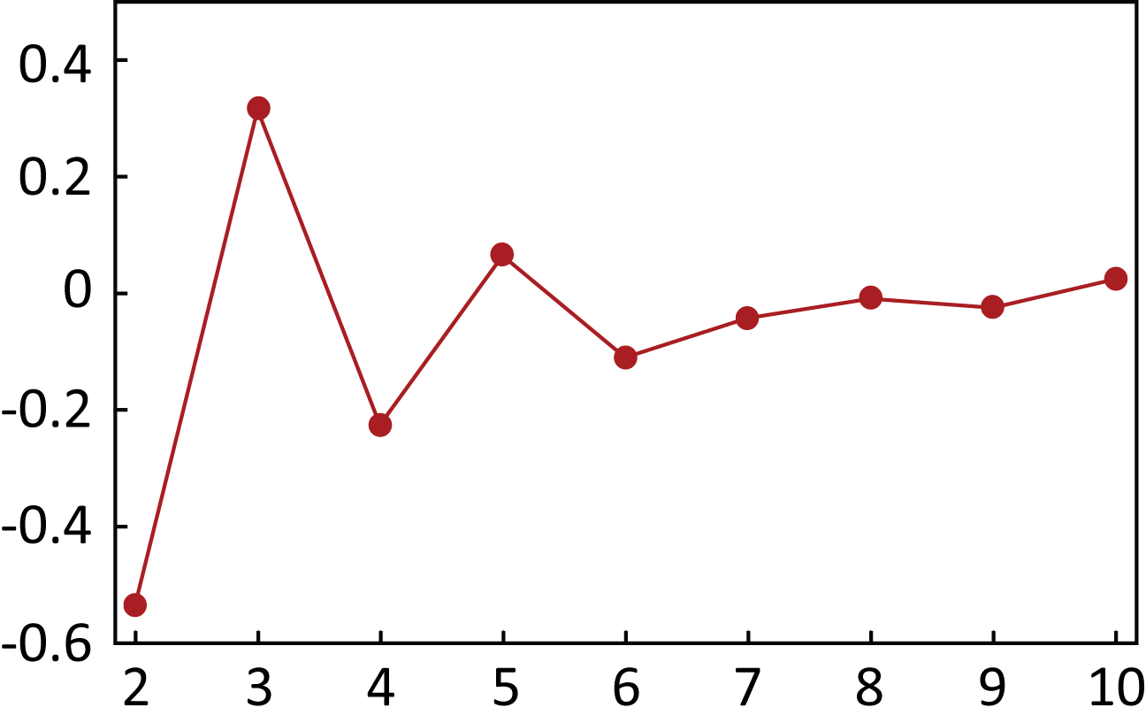
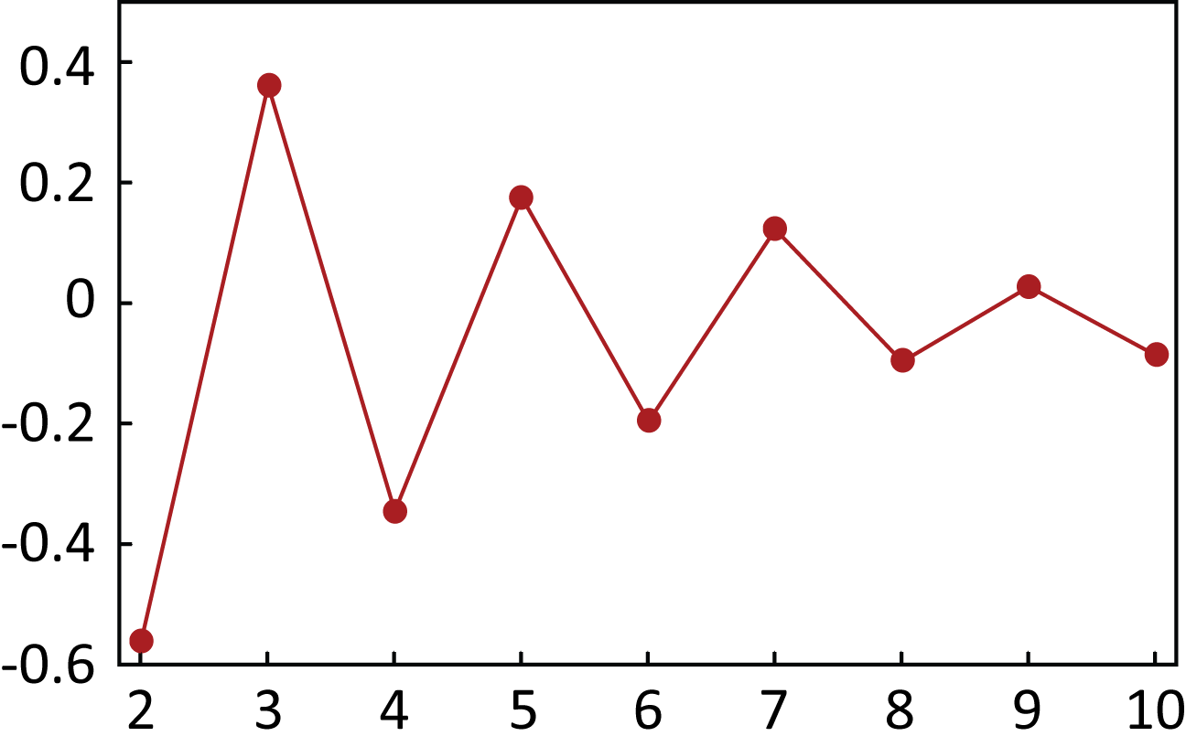
Long Range Antiferromagnetism (N=10)
12
B
6
J_{i,j} ∝
1
|i−j|^{1.1}
0
Time/τ
0
2.5
5
pair correlation
G_{1,j} =
Ion index, j

Slide 20
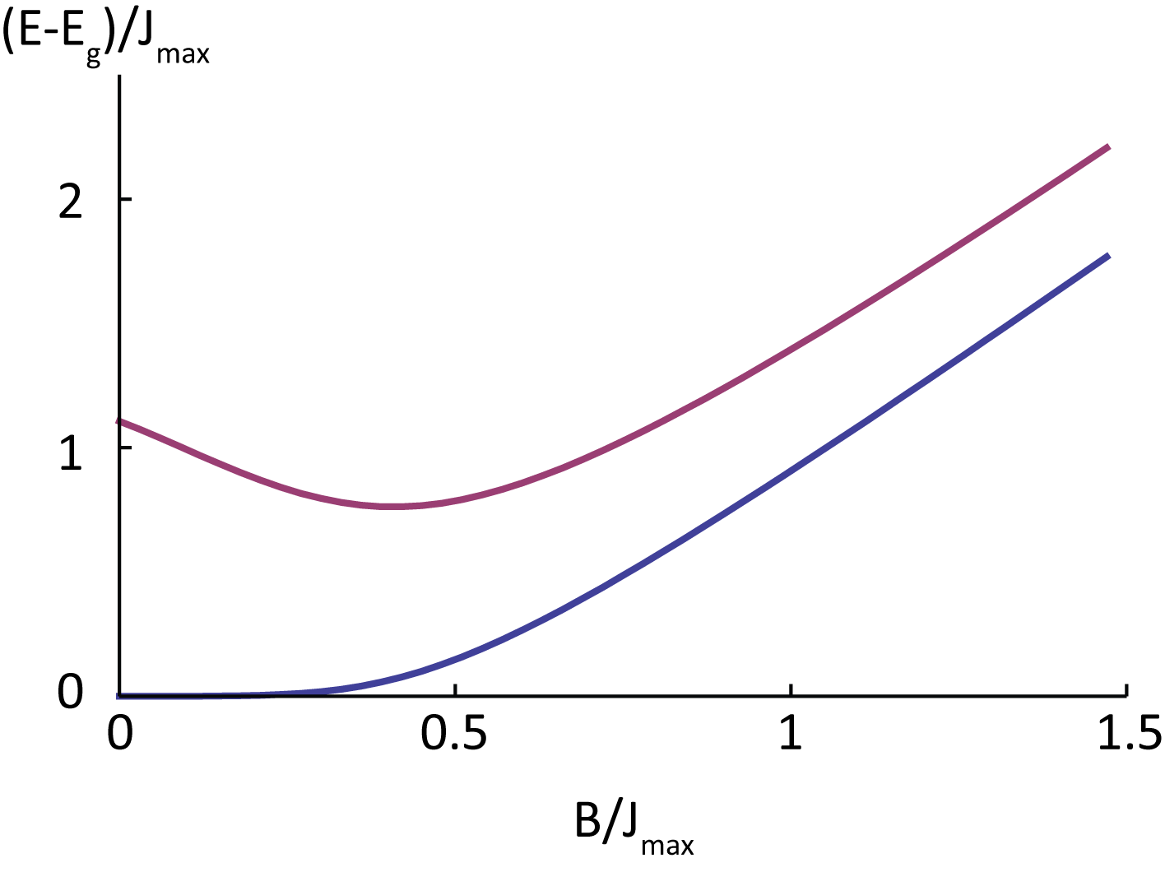
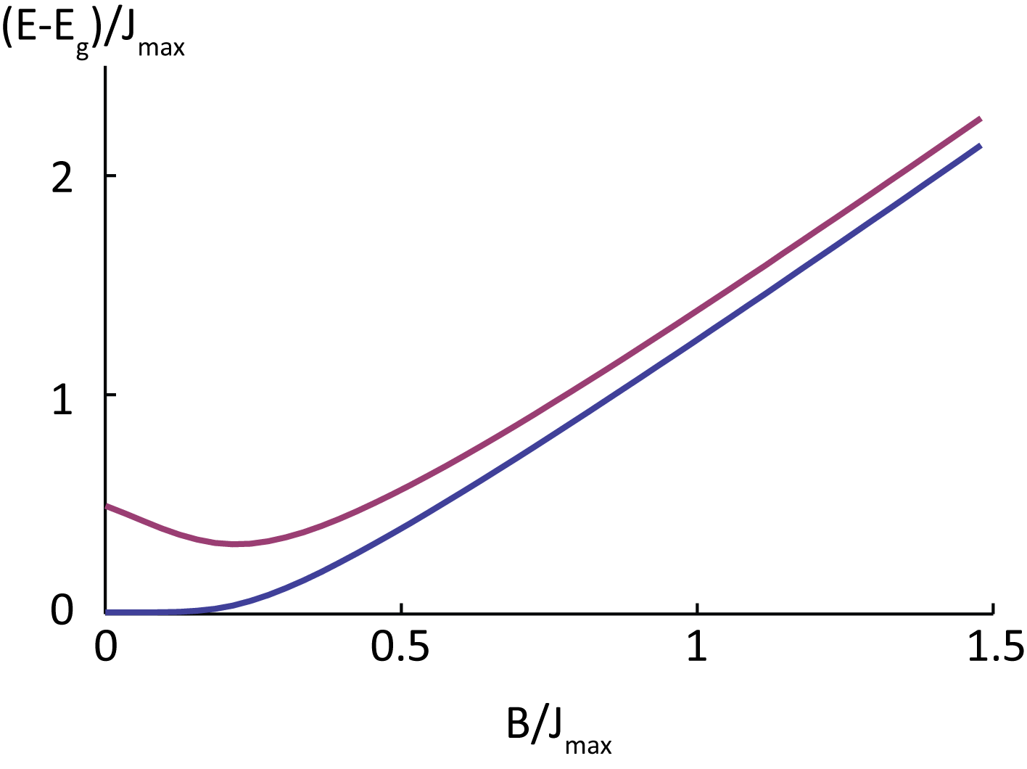
Frustration and energy gaps
Ground state Neel ordered:
Abandoning adiabaticity probes frustration
Low-lying energy states in antiferromagnetic model
Short range:
exponent 1.5
Long range:
exponent 0.5

Slide 21
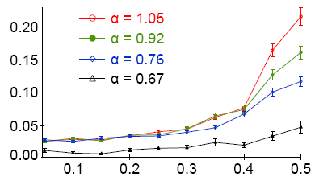
Frustration of Magnetic Order (N=10)
Short range
Structure
Function
Long range
Spatial frequency k (2π)
R. Islam et al., Science
340, 583 (2013)

Slide 22
Antiferromagnetic Néel order of N=10 spins
2600 runs, α=1.12
All in state ↑
All in state ↓
AFM ground state order
222 events
219 events
441 events out of 2600 = 17%
Prob of any state at random =2 x (1/2¹⁰) = 0.2%
R. Islam et al., Science
340, 583 (2013)
Notes:
Since we are able to image each ion individually using the camera, we can directly observe an increase in the number of excitations as we move to long-range afm interactions. For instance, with 10 spins, we can easily see the difference between when each of our spins is up and when each is down.
If we turn on our antiferromagnetic hamiltonian, we can then image our degenerate Neel ordered ground state. If we perform 2600 simulations of our AFM hamiltonian with a range of interaction parameterized by this alpha, we find
About 220 events for each of the ground states, or 17 percent probability of landing in the ground state. Compared to the probability of falling into these states at random, it’s clear that we’re still recovering some ground state character.
1:00 – 16:00

Slide 23
First Excited States
(Pop. ~2% each)
Notes:
Of course we can also look at the first excited states, that have a single defect like having two down spins next to each other, or two up spins, and find that they are not nearly as prevalent as the ground state, but still more populated than random chance would give.

Slide 24
Second Excited States
(Pop. ~1% each)

Slide 25
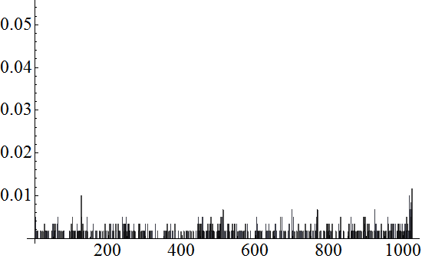
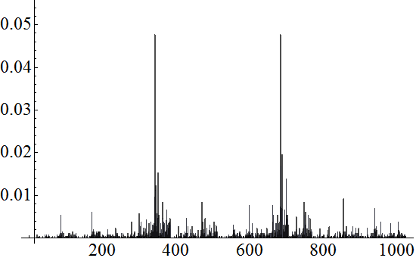
Distribution of all 2¹⁰ = 1024 states
Initial
paramagnetic
state
B >> J₀
Probability
0.10
0.08
0.06
0.04
0.02
0101010101
1010101010
Nominal
AFM
state
B << J₀
Probability
0 341 682 1023
R. Islam et al., Science
340, 583 (2013)
Notes:
In fact, using the camera we can look at the distribution of all 1024 possible states in the system. In the initial paramagnetic state, all possible spin configurations are roughly equally populated, save for a few detection errors.
When we ramp down the Hamiltonian, we see the two ground states popping out very clearly, each with about 9% probability, and the rest of the states suppressed.
:30 – 16:30

Slide 26
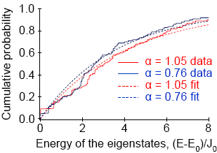
Distribution of states ordered by energy (N=10)
Thermalization??
α = 1.12
α = 0.86
Cumulitive Prob
Energy/J₀
R. Islam et al., Science
340, 583 (2013)

Slide 27
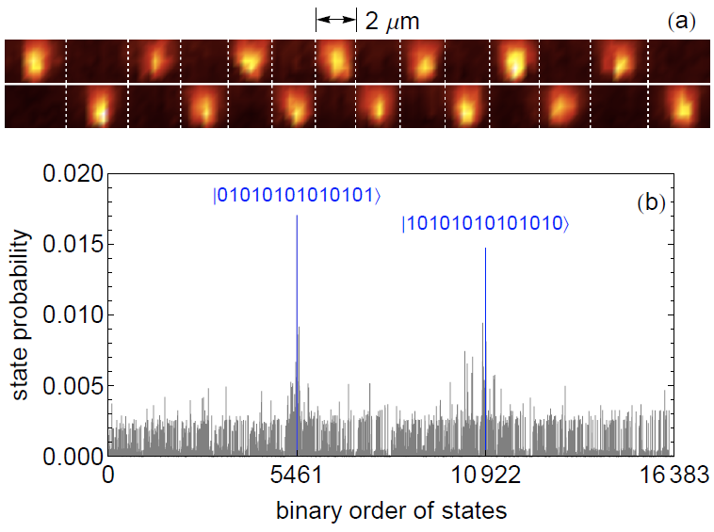
AFM order of N=14 spins (16,384 configurations)

Slide 28
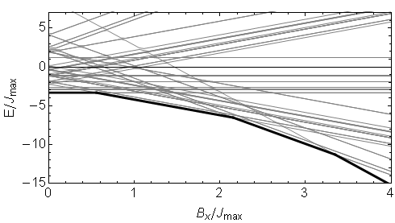
AFM Ising with AXIAL field
At B_{y} = 0:
=
=
Notes:
Let's consider the ground state of this Hamiltonian when we set the transverse field part equal to zero.
For N=6, we can plot the energy eigenvalues as we vary the strength of Bx. We find that at three points, the ground state energy has abrupt kinks in it.
We can look at the ground state spin-configurations in each of these regions. Near Bx=0, we have our AFM states, as expected. However in this region, it becomes energetically favorable for one of the spins to flip from up to down to align along the longitudinal field. Likewise, past the next phase transition, another spin goes dark, and finally at large Bx, all of the spins are polarized along the longitudinal field.
If we plot an order parameter like the number of ions bright as a function of Bx, we see a staircase with abrupt jumps at the phase transitions.

Slide 29
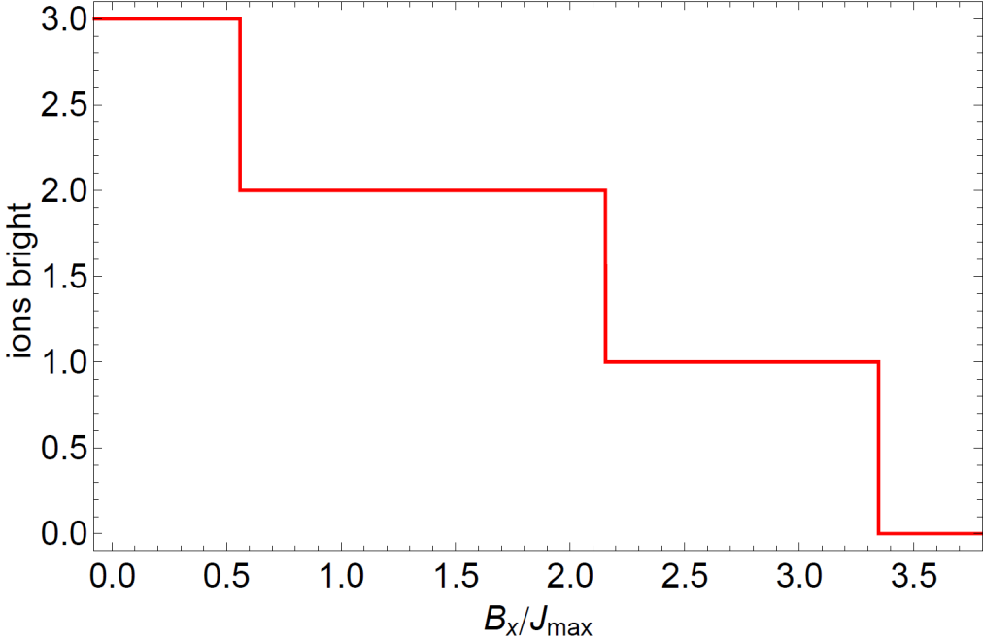
AFM Ising with AXIAL field
Notes:
I have already showed you the theory prediction for the number of ions bright as the strength of Bx is increased.

Slide 30
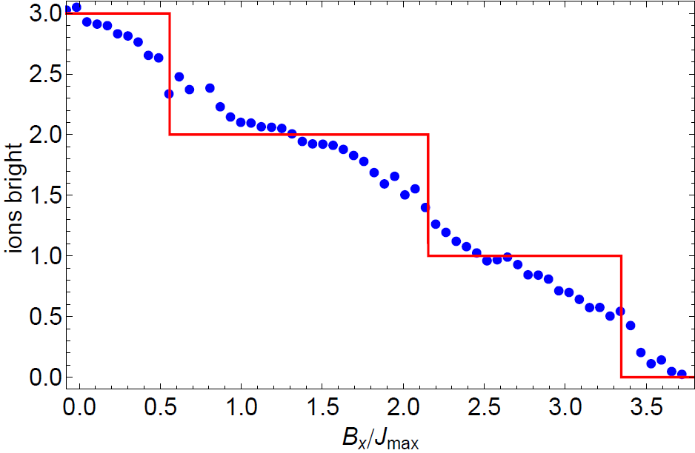
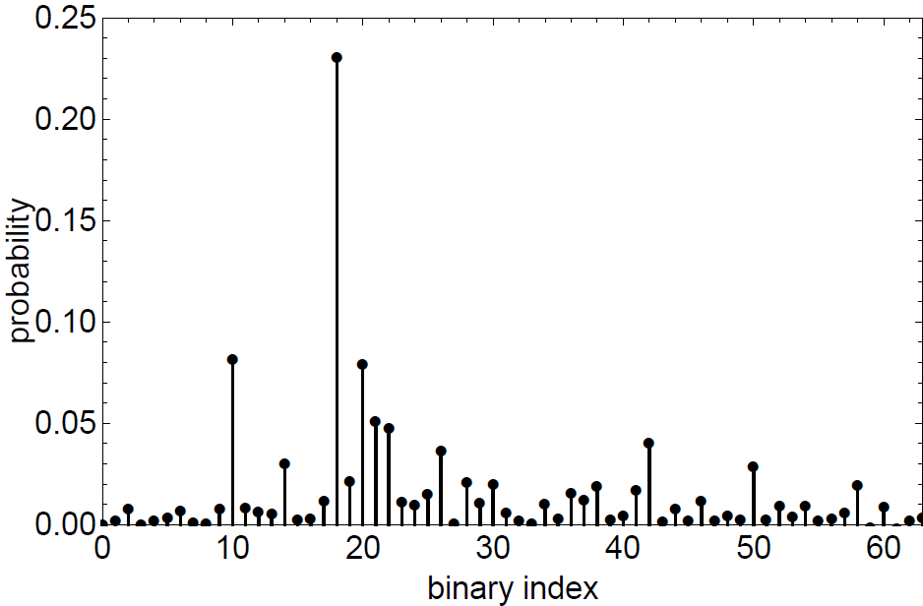
AFM Ising with AXIAL field
010010
Notes:
When we take experimental data, we trace out a curve given by these blue points here. Although there is some behavior along the way showing correspondence to the plateaus, in general the steps are heavily rounded since it is difficult to remain adiabatic when the energy gaps are so small.
However, we can still recover the ground state ordering by using the idea presented before, that the ground state will be the most prevalent state.
For any of these blue data points, we can look at the probability of all possible spin orderings, from which a most prevalent state is selected. In this case, we have the state 010010, with two ions bright. Selecting the most probable state for each point,

Slide 31
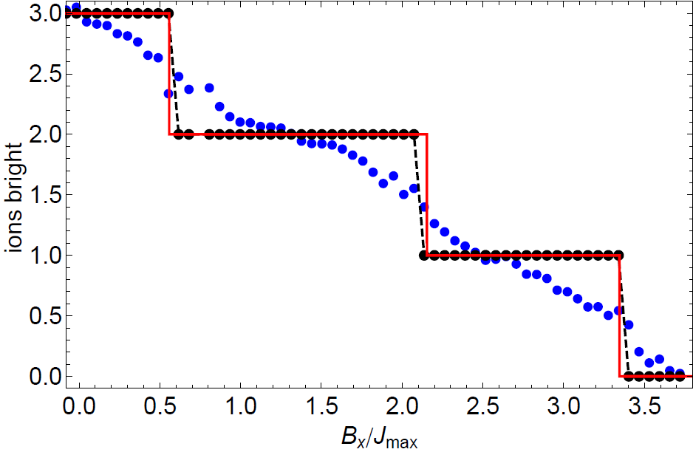
AFM Ising with AXIAL field
AFM Ground States
2-Bright Ground State
1-Bright Ground States
010010
0-Bright Ground State
P. Richerme, et al., ArXiv 1303.6983 (2013)
Notes:
we nicely recover the expected number of bright ions as Bx is increased.
And again, since we are using the camera to take direct images of the data, we can see and confirm the states that we're making.
1:30 – 23:30

Slide 32
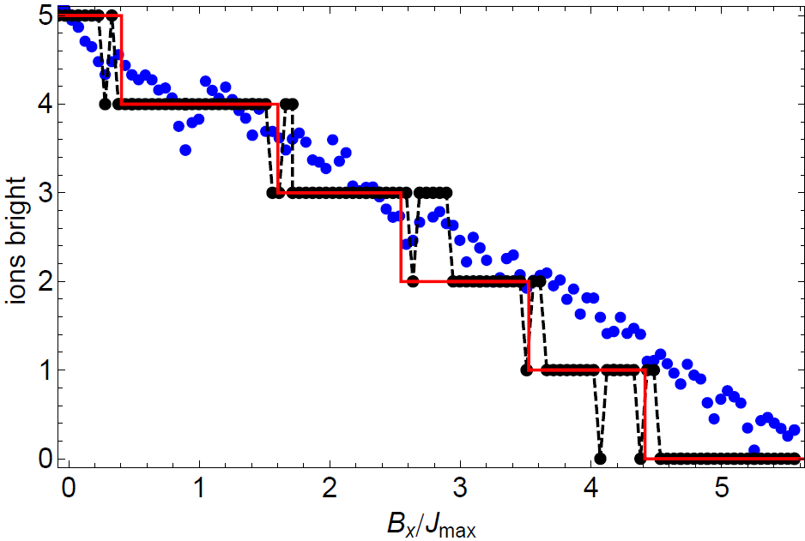
AFM Ising with AXIAL field
5-Bright (AFM) Ground States
4-Bright Ground States
3-Bright Ground States
2-Bright Ground States
1-Bright Ground States
System exhibits a complete
devil's staircase for N → ∞
0-Bright Ground State
P. Bak and R. Bruinsma, PRL 49, 249 (1982)
P. Richerme, et al., ArXiv 1303.6983 (2013)
Notes:
1:30 – 25:00

Slide 33
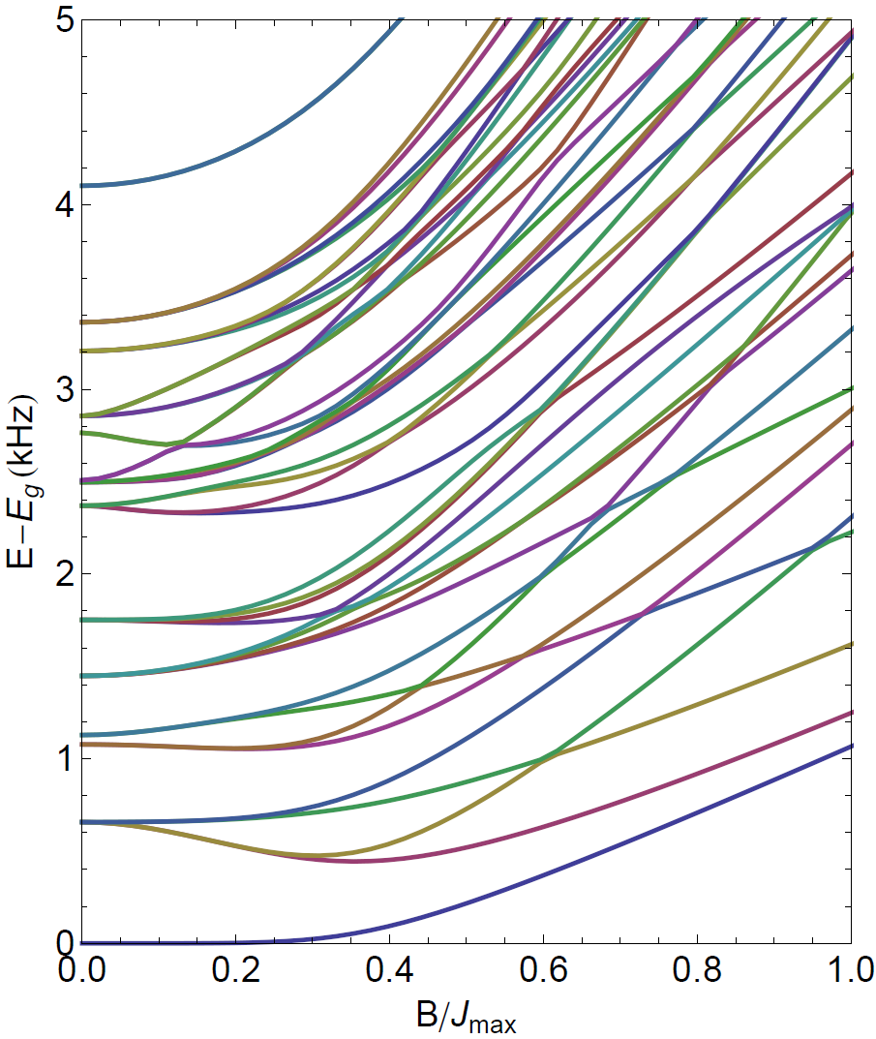
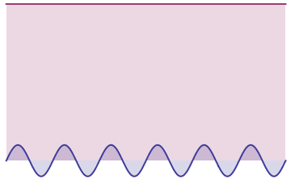
Dynamics: many-body spectroscopy
Modulate transverse B field to drive transitions between ground and excited states
J_{x}^{i,j}
amplitude
B_{y}
time
C. Senko et. al., in preparation

Slide 34
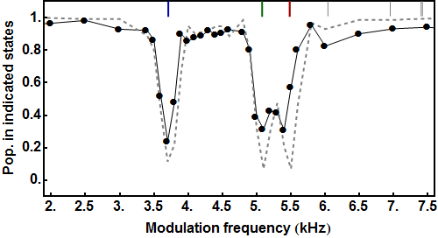
N = 6
Dynamics: many-body spectroscopy
J_{x}^{i,j}
amplitude
B_{y}
time
Start from
Drive to
C. Senko et. al., in preparation

Slide 35
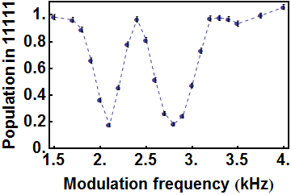
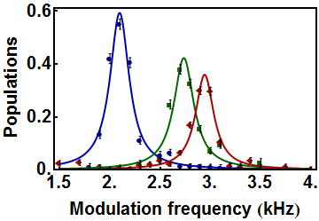
N = 5
Dynamics: many-body spectroscopy
J_{x}^{i,j}
amplitude
B_{y}
time
Start from
Drive to
C. Senko et. al., in preparation

Slide 36
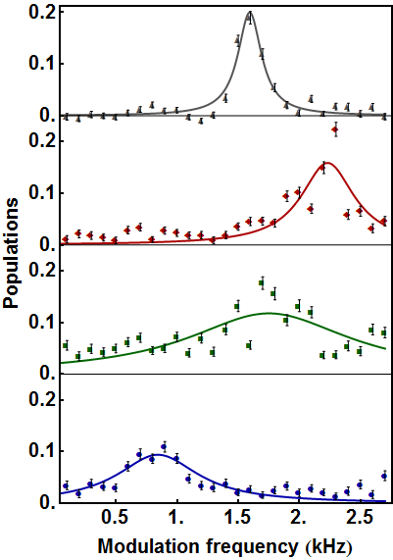
N = 5
Dynamics: many-body spectroscopy
Start from
Drive to
C. Senko et. al., in preparation

Slide 37
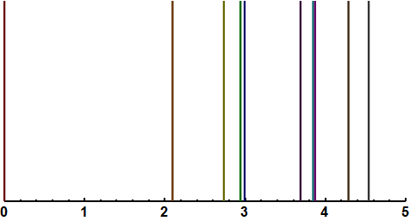
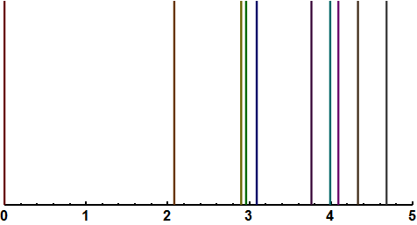
N = 5
Dynamics: many-body spectroscopy
Complete spectrum of 5 spins
Spin states in
order of energy
Measurement
Theory
Modulation frequency (kHz)
C. Senko et. al., in preparation

Slide 38
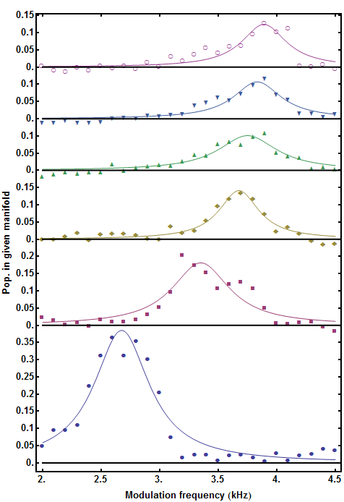
N = 12
Dynamics: many-body spectroscopy
111111011111
111110111111
111111101111
111101111111
111111110111
111011111111
111111111011
110111111111
111111111101
101111111111
111111111110
011111111111
C. Senko et. al., in preparation

Slide 39
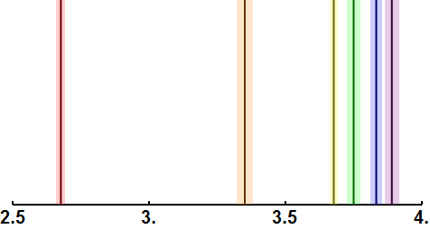
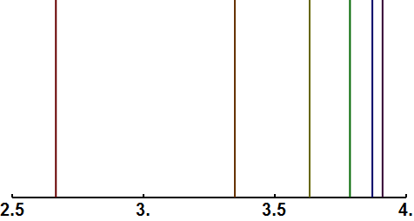
N = 12
Dynamics: many-body spectroscopy
Measurement
111111101111
111101111111
111111110111
111011111111
Theory
111111111101
101111111111
111111111110
011111111111
Modulation frequency (kHz)
C. Senko et. al., in preparation

Slide 40
Dynamics: quantum engineering (FM: N=4)
Drive system with all frequencies simultaneously
(and control relative phases)
Create equal superposition of single-spin flip states
(W state)
FM Population
+
+
Ψ
=
+
+
+
C. Senko et. al., in preparation

Slide 41
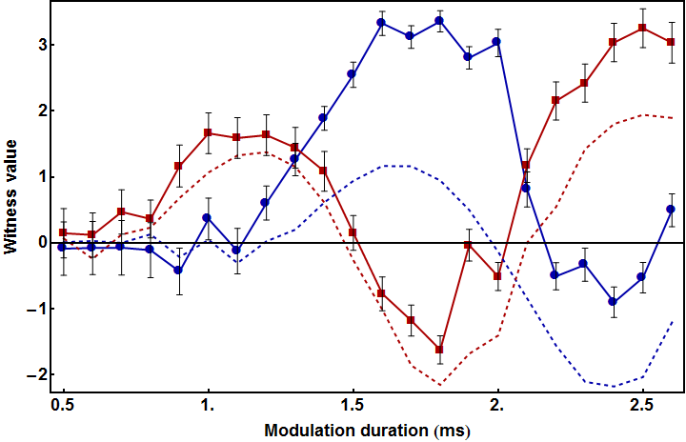
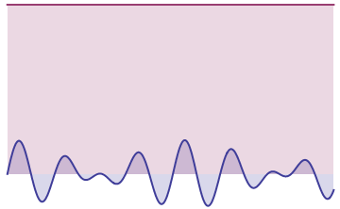
Dynamics: quantum engineering (FM: N=4)
Ψ
=
+
+
+
φ = 160°
φ = 340°
J_{x}^{i,j}
amplitude
B_{y}
time
entangled
C. Senko et. al., in preparation

Slide 42
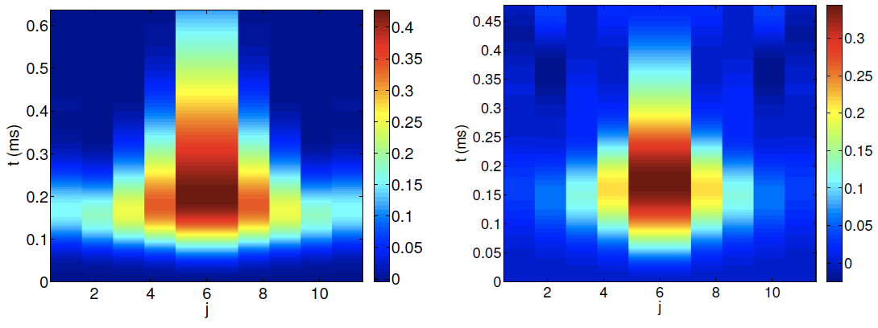
Dynamics: “light cone” of interaction propagation
with long range interactions
E.H. Lieb and D.W. Robinson, “The finite group velocity of quantum spin systems,” Commun. Math. Phys. 28, 251–257 (1972).
“Ising Quench”
Prepare (↓+↑)^{⊗N} “kT = ∞”
Meaure correlations C_{midpoint, j} (t)
N=11 J₀=0.5kHz α=0.81
N=11 J₀=0.5kHz α=1.3
N=41
α=2.5
N=41
α=1.5
N=41
α=0.5
longer range
shorter range
Theory: Z. Gong and A. Gorshkov (JQI)
neutrals (nearest-neighbor interactions): M. Cheneau et al., Nature 481, 484 (2012)

Slide 43
Dynamics: L-R bounds with long range interactions
Preliminary
Data
N=11 spins

Slide 44
Up next…
Formation of localized defects: nonequilibrium dynamics
M. Knap, E. Demler, I. Bloch (in preparation)
XY model
Spin-1: topological excitations
Programmable fully connected spin network
interactions
N beams, each with
N spectral components
S. Korenblit, et al., New. J. Phys. 14, 095024 (2012)

Slide 45
Example:
programming a 2D kagome lattice with a linear chain of 36 ions
Theory
atom #
spectral component
J. Garcia-Ripoll et al., Phys. Rev. A 71, 062309 (2005)
S. Korenblit et al., ArXiv 12010776 (2012)

Slide 46
GET MORE SPINS!!
16 spin AFM simulation
18 spin FM simulation
B/J = 0.01
B/J = 5
Probability
m_{x} = total spin along x

Slide 47
Global Spin Detection: 16 ions
N=0 (↓↓↓↓↓↓↓↓↓↓↓↓↓↓↓↓)
Photon count histograms for N=16 ions
N=1
N=8
N=16 (↑↑↑↑↑↑↑↑↑↑↑↑↑↑↑↑)
# photons
Notes:
B/J: 5, 1.5, 0.03

Slide 48
Quantum simulation with N=16 ions
N=0 (↓↓↓↓↓↓↓↓↓↓↓↓↓↓↓↓)
Theoretical photon count histograms
Ferro couplings
Anti-ferro couplings
N=8
N=16 (↑↑↑↑↑↑↑↑↑↑↑↑↑↑↑↑)
# photons
Ferro couplings
paramagnetic
polarization
B>>J
G(1,j)
B>>J
Quantum
Phase
Transition
B ~ J
B ~ J
Decreasing
B/J
G(1,j)
B << J
B << J
FM/AFM
order
Distance from 1st ion, j

Slide 49
~few 100
Be⁺ ions in
a Penning Trap
Quantum
Hard-drive?
J. Britton et al., Nature 484, 489 (2012)

Slide 50
Going Cold: N>50

Slide 51
Maryland/LPS
GaAs/AlGaAs
GaTech
Res. Inst.
Al/Si/SiO₂
NIST-Boulder
Au/Quartz
Sandia Nat’l Lab: Si/SiO₂

Slide 52
a (C.O.M.)
b (stretch)
Mode competition –
example: axial modes, N = 4 ions
c (Egyptian)
d (stretch-2)
60
b+c
d
c
mode
amplitudes
b
2b,a+c
a+b
c-a
b-a
2a
b-a
c-a
b+c
cooling beam
Fluorescence counts
a
a+b
2b,a+c
40
2a
d
carrier
a
b
axial modes only
c
20
-15
-10
-5
0
5
10
15
Raman Detuning δ_{R} (MHz)
D. Kielpinski, CM, D. Wineland, Nature 417, 709 (2002)

Slide 53
Large scale vision (10³ – 10⁶ atomic qubits?)
0.001 Hz then, ~1 Hz now, ~1 kHz soon
New hierarchical and modular quantum computer architecture
Different model for circuit optimization
Error correction thresholds exist! (R. Raussendorf)
C.M., et al., ArXiv 1208.0391 (2012).

Slide 54
ENIAC (1946)
Solid-state transistor (1947)

Slide 55
right idea, wrong platform

